Slide 1
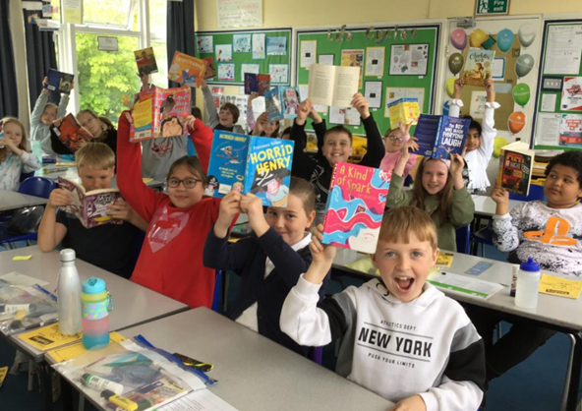
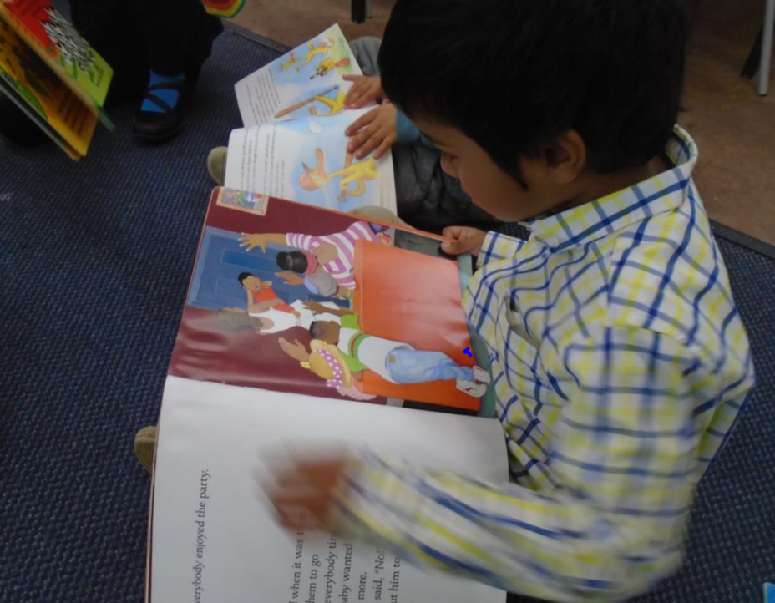
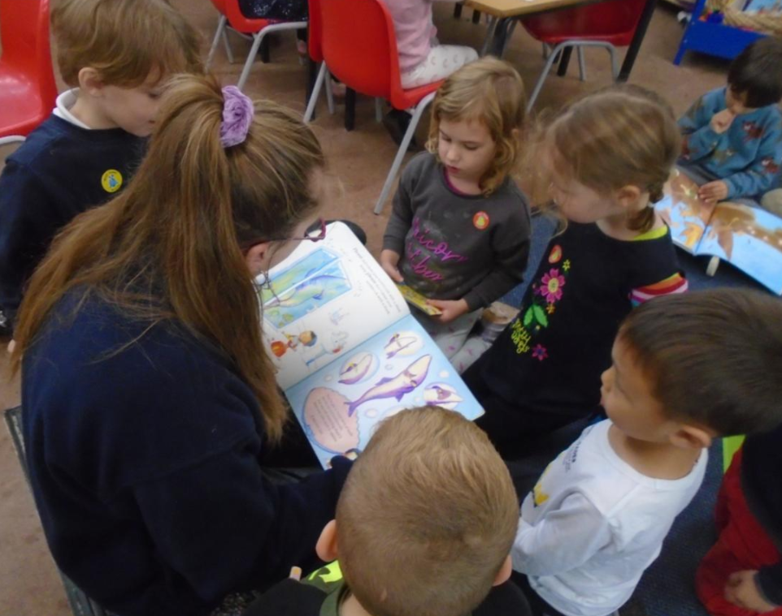
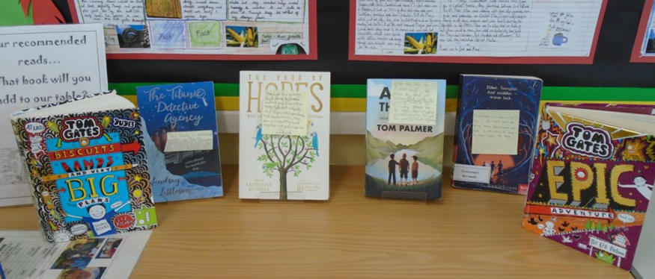
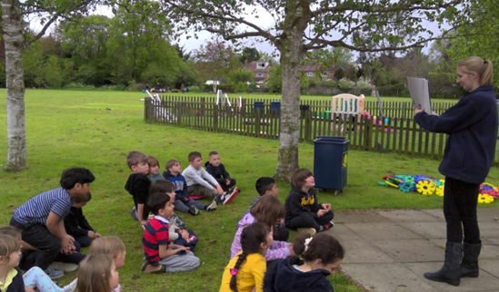
Reading for Pleasure Arbury Primary School
Kate Dowdall- February 28th 2022

Slide 2
What is reading for pleasure?
At the core of what reading for pleasure is, is the reader’s intrinsic motivation to read. Basically, the child WANTS to read or be read to. This means reading for its own sake, rather than reading for other awards.
‘Reading enjoyment has been reported as more important for children’s educational success than their family’s socio-economic status.’ (OECD, 2002).
The National curriculum states:
The overarching aim for English in the national curriculum is to promote high standards of language and literacy by equipping pupils with a strong command of the spoken and written language, and to develop their love of literature through widespread reading for enjoyment.
The top two reading aims for children to achieve in the National Curriculum are:
To read easily, fluently and with good understanding.
To develop the habit of reading widely and often for both pleasure and information

Slide 3
Why does reading for pleasure matter?
Reading for pleasure has many benefits for wellbeing and mental health. Research has shown that reading raises self-esteem.
Research shows that children who read more are also more empathic.
Reading together creates communities- it is a wonderful way for people to connect and bond.
Students who read regularly for pleasure do significantly better academically across the curriculum (including 10% better in maths).
Reading widely improves vocabulary, something that is essential for success in all subjects and in later life.
Reading is linked inextricably to writing: usually, children who read widely have a better grasp of language, sub-consciously absorb models for their own writing and even develop more secure spelling habits.
Reading helps to increase children’s general knowledge, knowledge and understanding of different cultures and of the wider world.
Reading allows children to explore more complex problems from the safe fictional world of books.
High levels of reading in pre-school children has been seen to help diminish the impact of language disorders.

Slide 4
How we foster a reading for pleasure culture at Arbury Primary School…

Slide 5
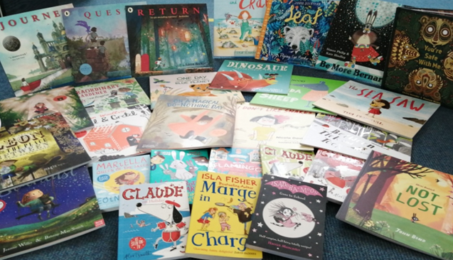
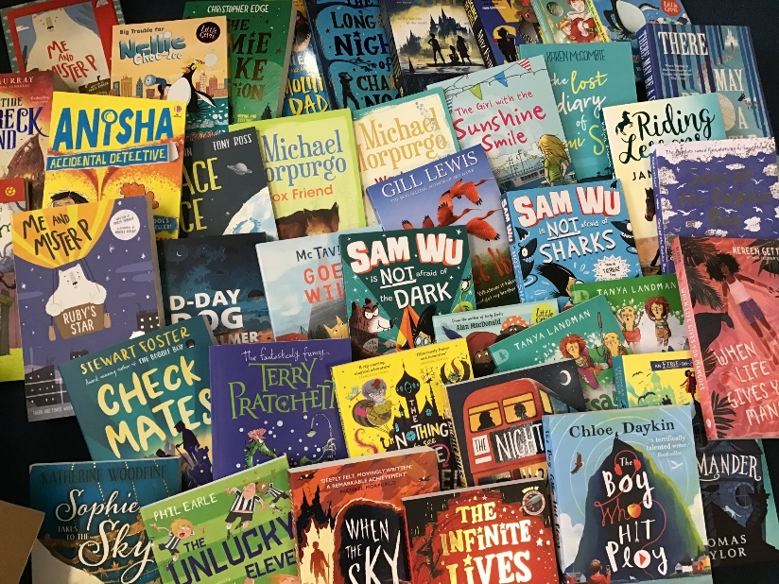
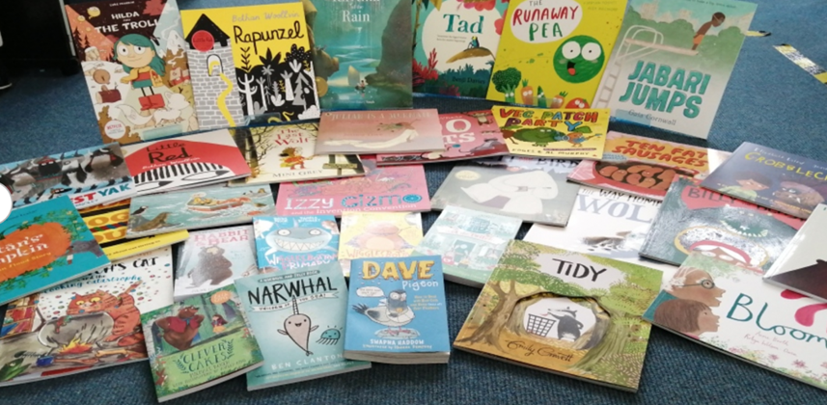
We have a HUGE book stock that is added to frequently with newly published, high quality literature. We prioritise spending the English budget on books, books and more books.

Slide 6
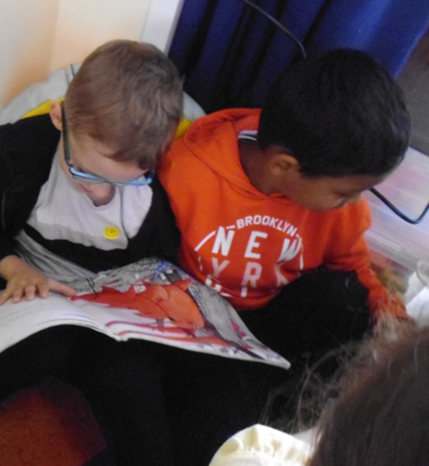
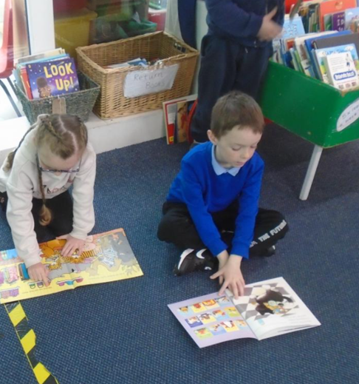
In every class we have well-stocked classroom libraries and we have whole school libraries dotted around the school that are used daily.

Slide 7
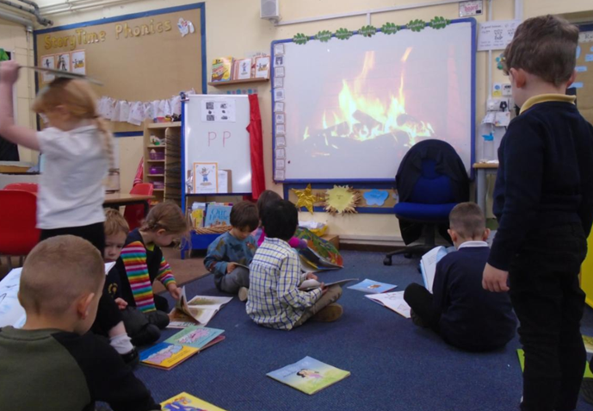
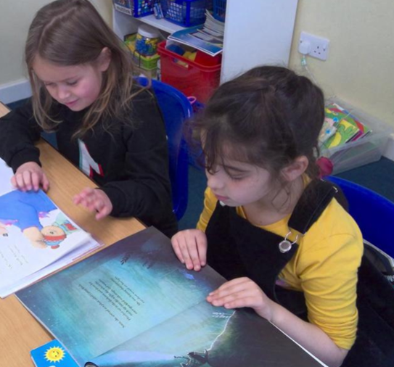
There are daily opportunities for story-time and independent reading time across the school. In Key Stage 1 there is a dedicated reading for pleasure session timetabled for once a week, where different reading for pleasure activities are enjoyed.

Slide 8
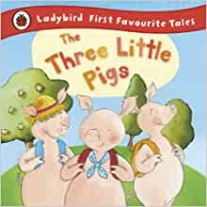
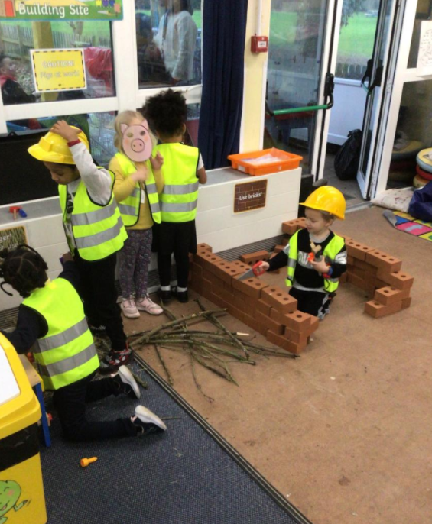
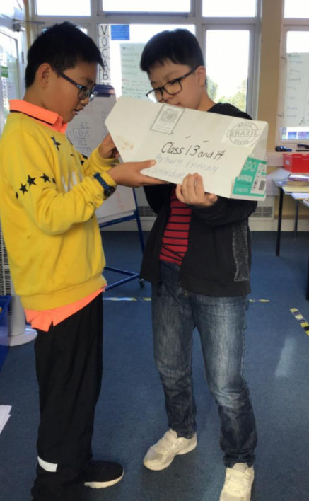
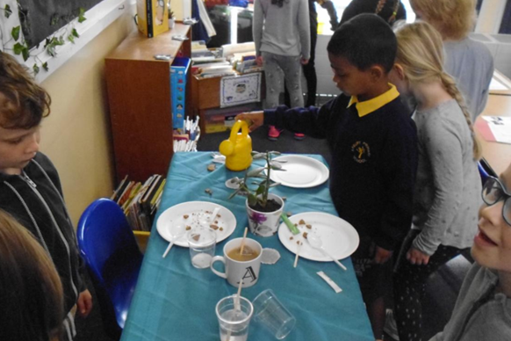
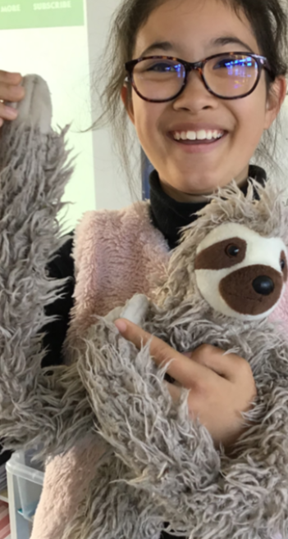
Our English curriculum is text-based. This means that the starting point for every writing unit is a high-quality text. Each three week writing unit starts with an engaging ‘hook to the book’ to get the children excited and engaged with their new text. We also teach whole class Guided Reading, which means that every child is exposed to a range of highly engaging, different text types which are packed full of high level vocabulary and language.

Slide 9
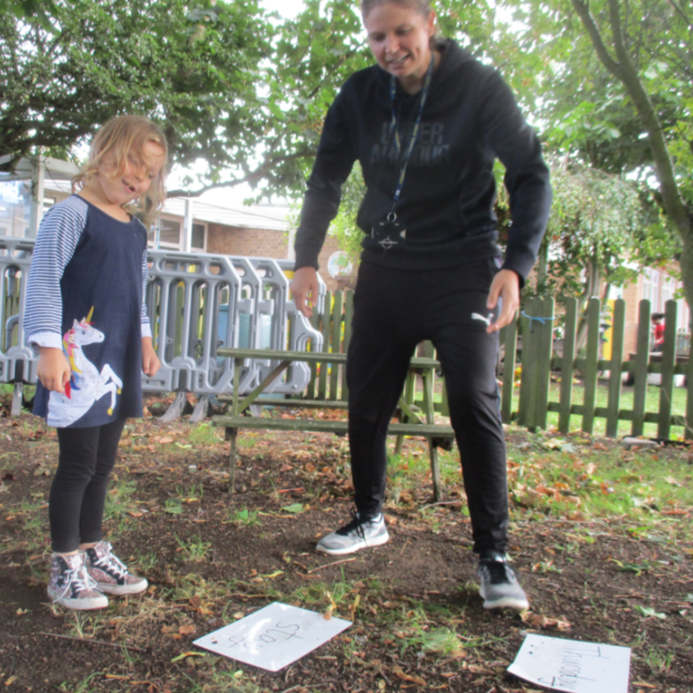
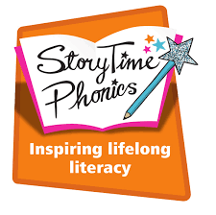
We use Story-time phonics in KS1 to teach phonics. It’s a systematic approach that uses real story books to contextualise the phonemes, ensuring high levels of engagement right from the start.

Slide 10
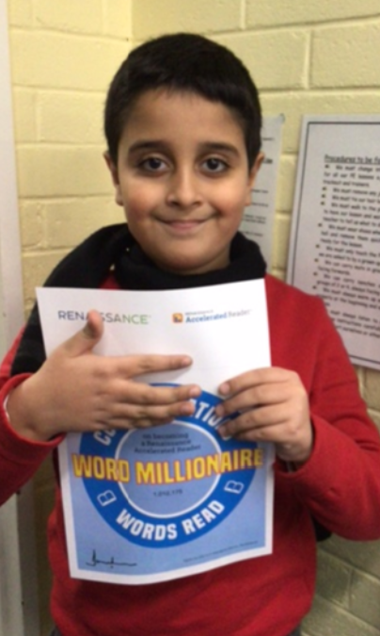
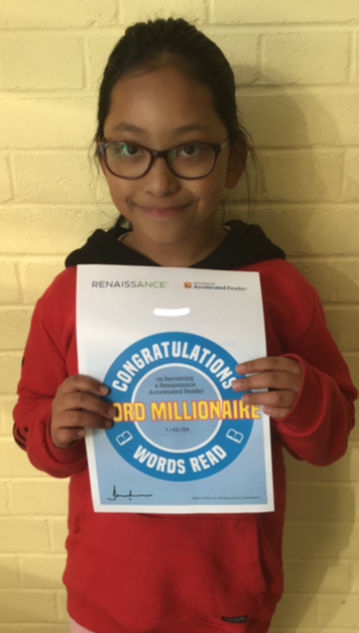
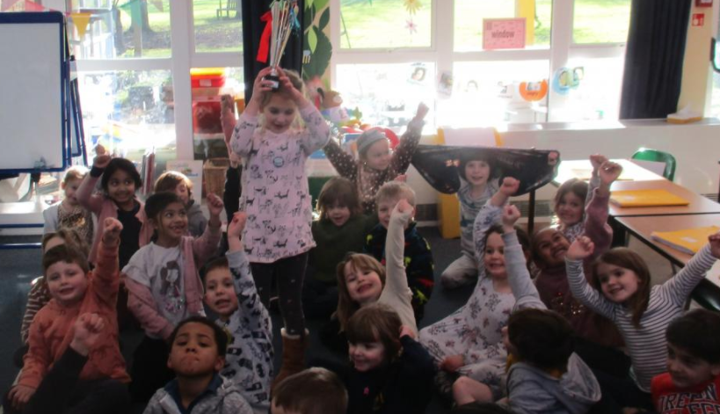
We monitor and encourage reading persistently. We give out reading trophies to classes who read the most. We use Accelerated Reader (usually Year 3 upwards). For some children, this helps to motivate them and allows staff to monitor closely children’s reading preferences and the quantity that children are reading. It also helps to identify any children that may be struggling and who may need extra support. We also reward those who read lots with ‘Word Millionnaire’ certificates.

Slide 11
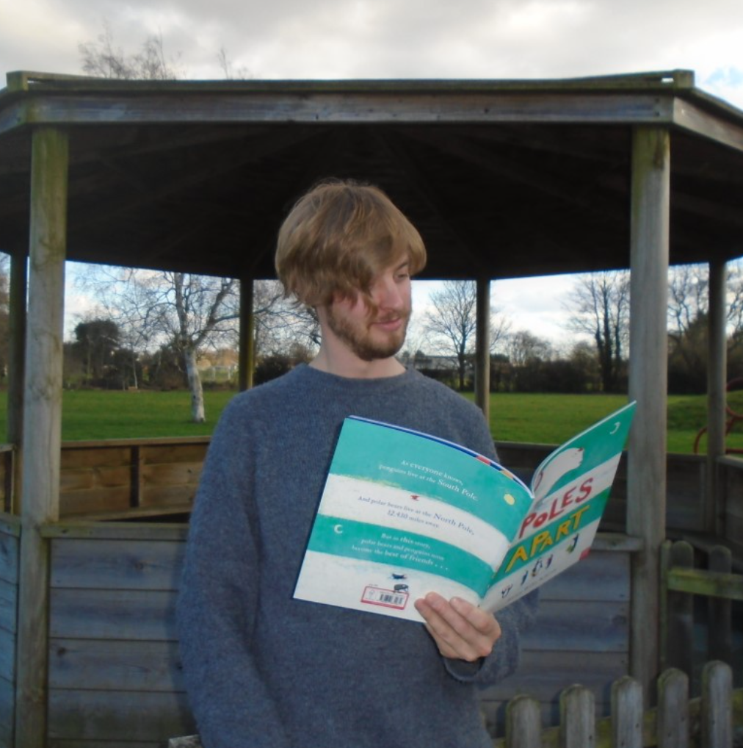
Staff are encouraged to develop themselves as reader teachers. This means they try to read children’s literature as much as they can in order to support children to choose books. Some of our staff have taken part in training with the Open University to learn more about how to foster children’s reading for pleasure.

Slide 12
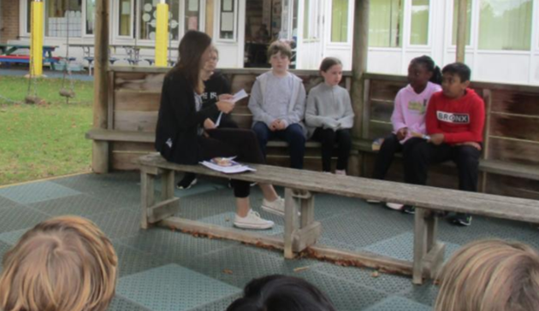
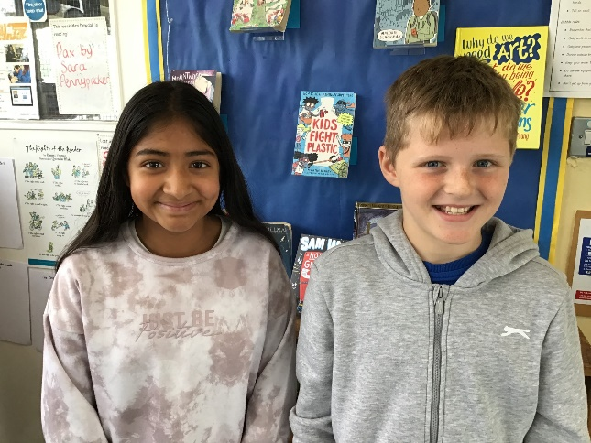
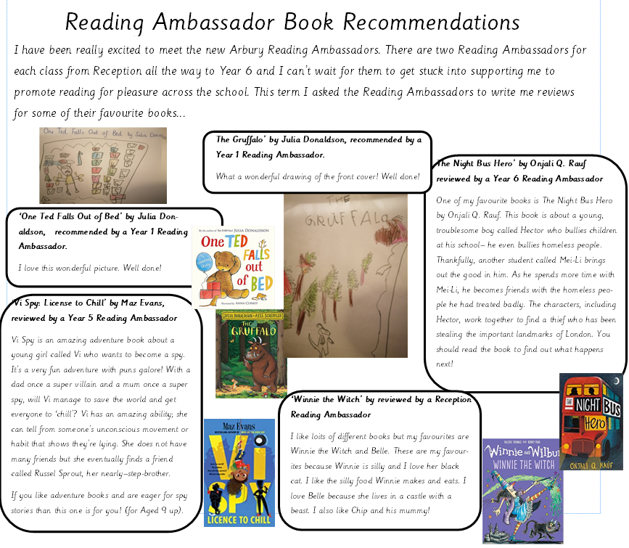
We have Reading Ambassadors in each class to help spread the joy of reading. We meet termly to discuss reading and complete reading tasks (e.g. writing reviews, making posters to promote reading). The UKS2 Reading Ambassadors also help to look after the KS2 library area.
A Reading Ambassador meeting…

Slide 13
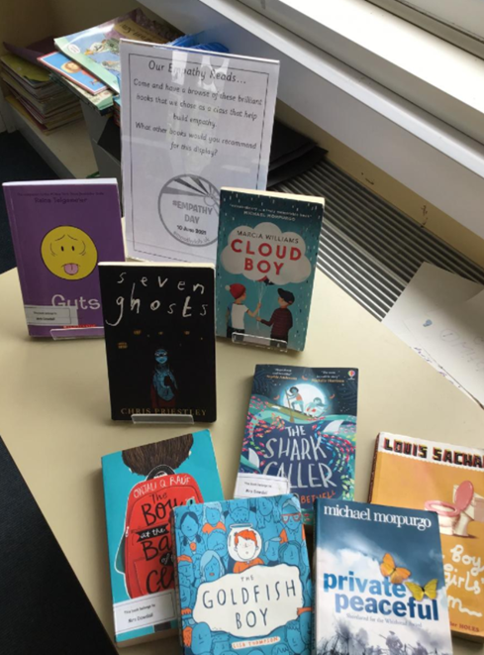
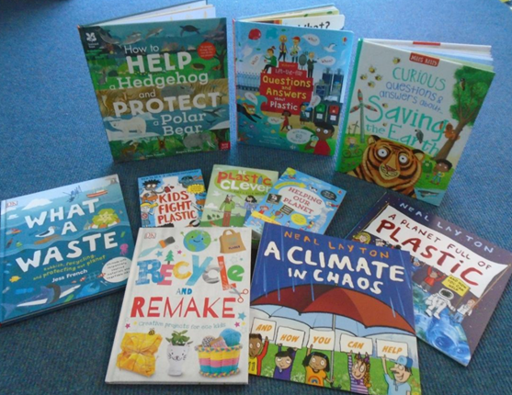
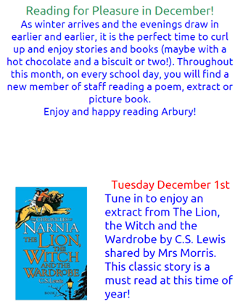
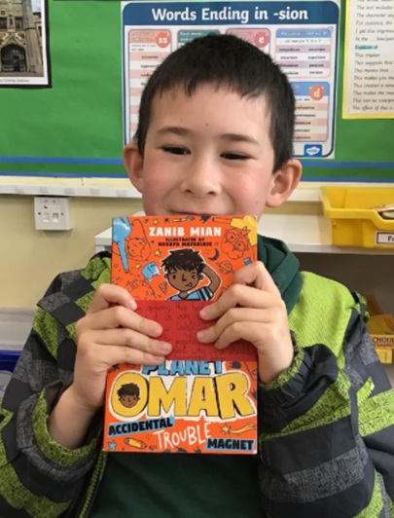
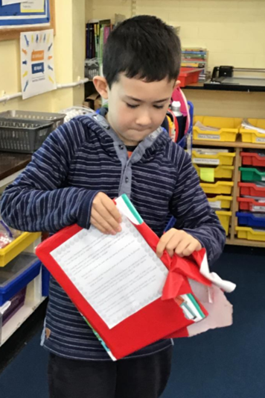
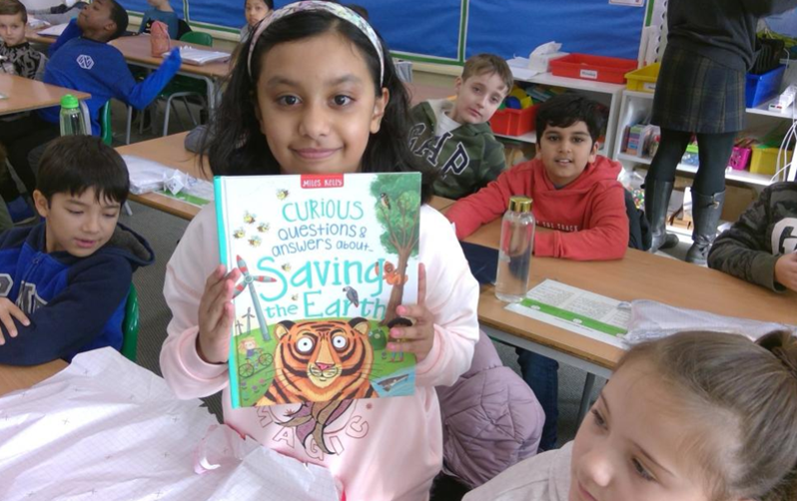
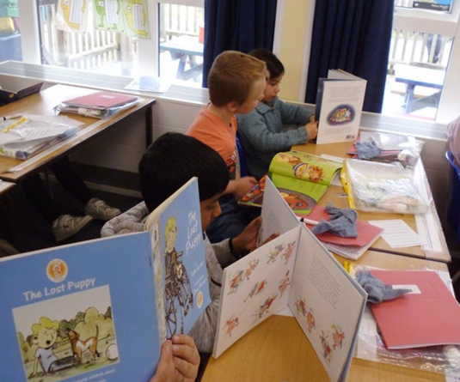
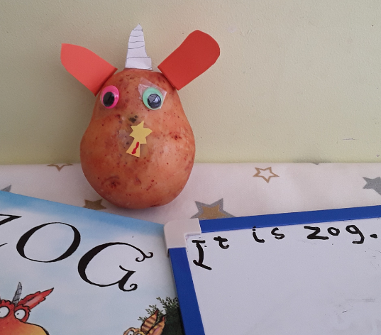
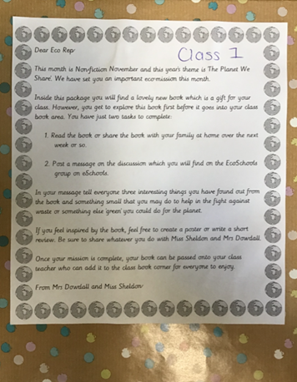
We have reading for pleasure events each half term (National Poetry Day, Anti-bullying week linked to a whole school text, DEAR days, World Book Day, Read for Empathy day, Non-fiction November etc). During the recent lockdowns, the ‘Reading Rooms’ were created on eschools. Daily stories and resources were uploaded to support parents and children to engage with reading for pleasure.

Slide 14
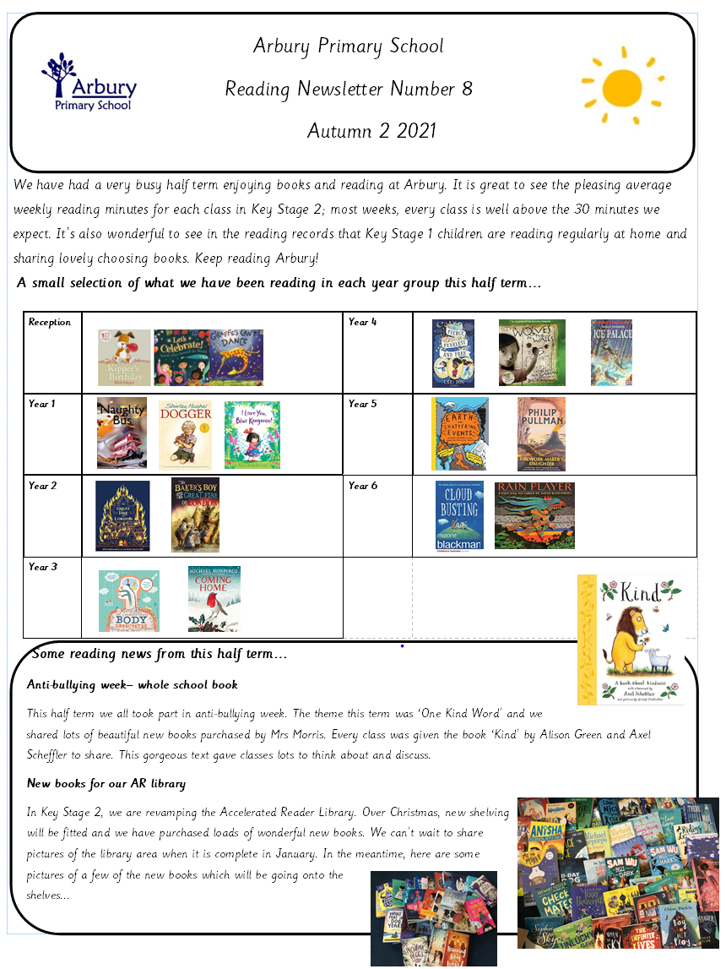
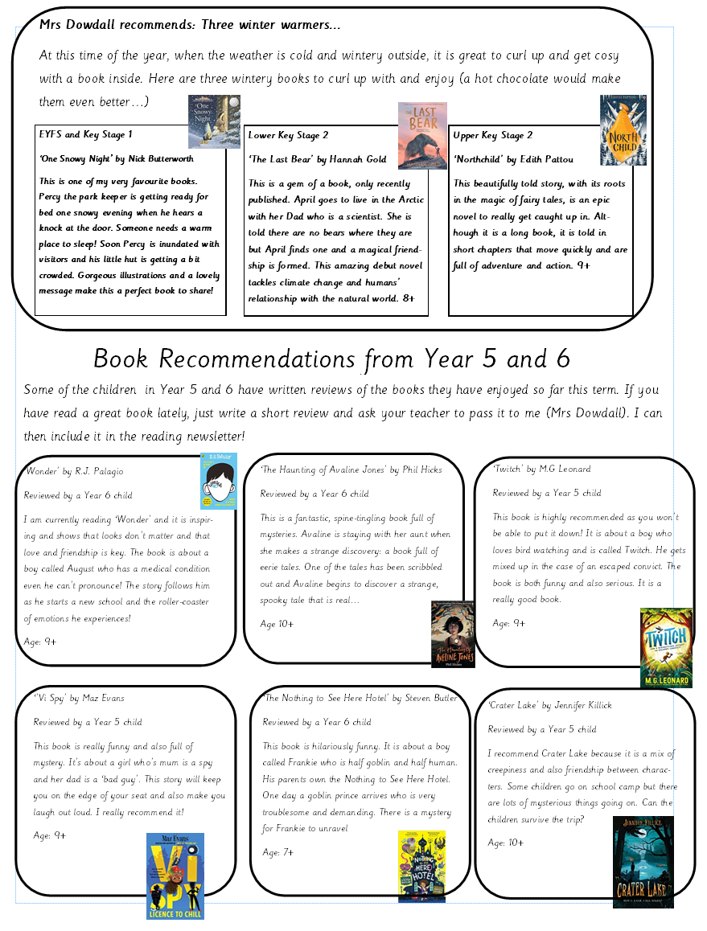
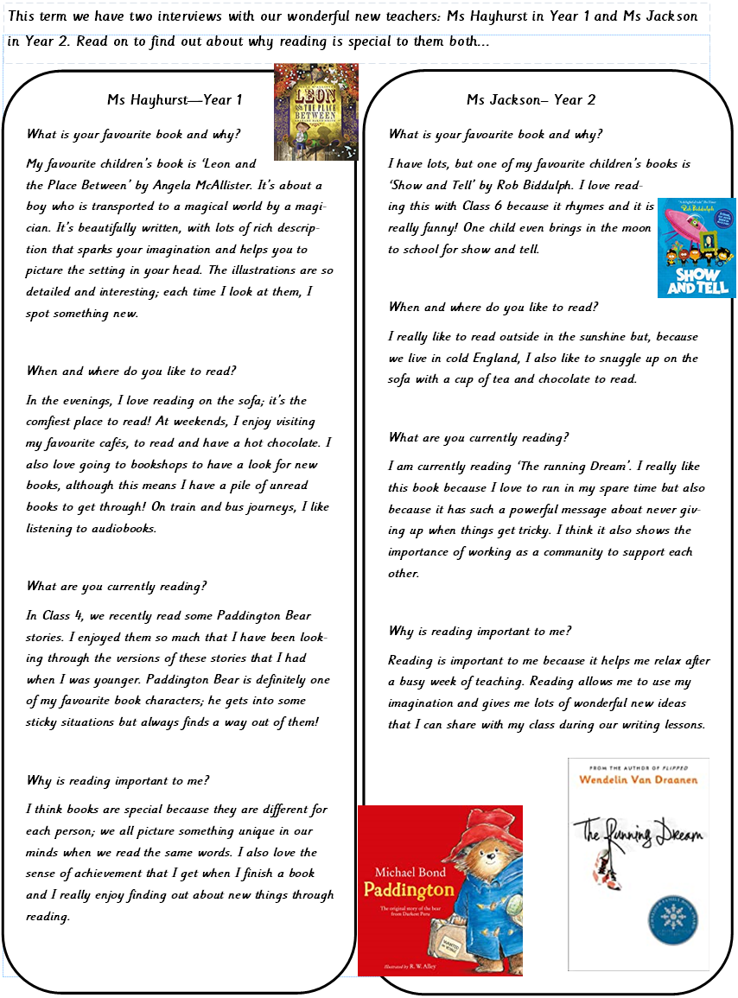
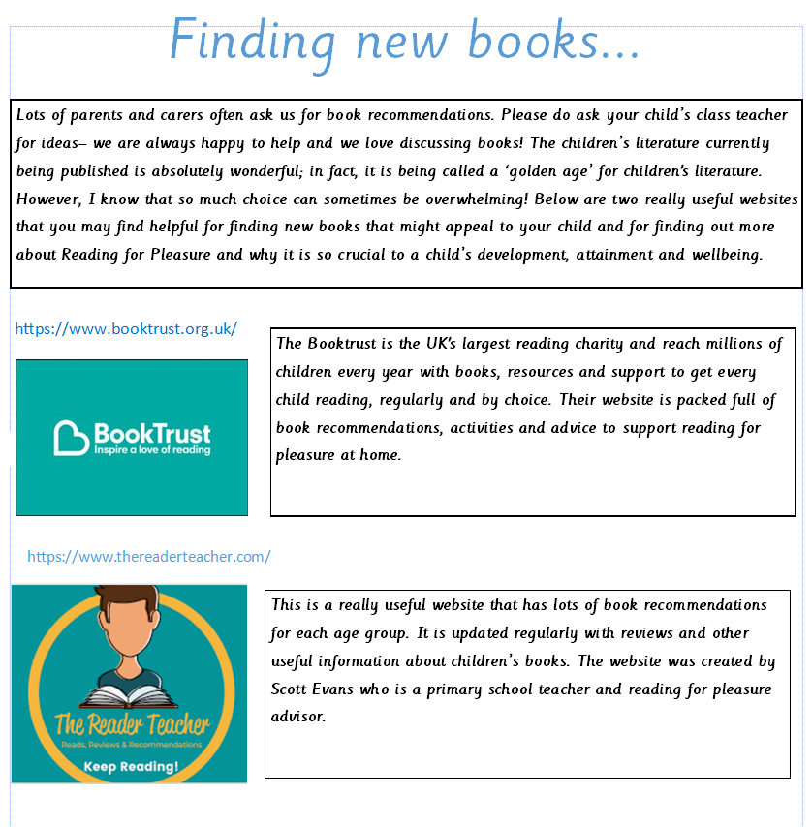
We publish a half-termly reading for pleasure newsletter for children, parents and staff to read.

Slide 15
How parents can support their children to become life-long readers
Get reading into your routine; many people find slotting reading in just before bed works really well.
Read to your older children- recent research suggests that only 32 percent of parents were reading to their children (under 13 years) each day, down 9 percent from 2012. In fact, the research shows that most parents stop reading to their kids by the age of eight.
Visit the library with your children.
Talk about books with your child- informal book chat is a great way to create bonds with your child as well as promoting reading for pleasure.

Slide 17
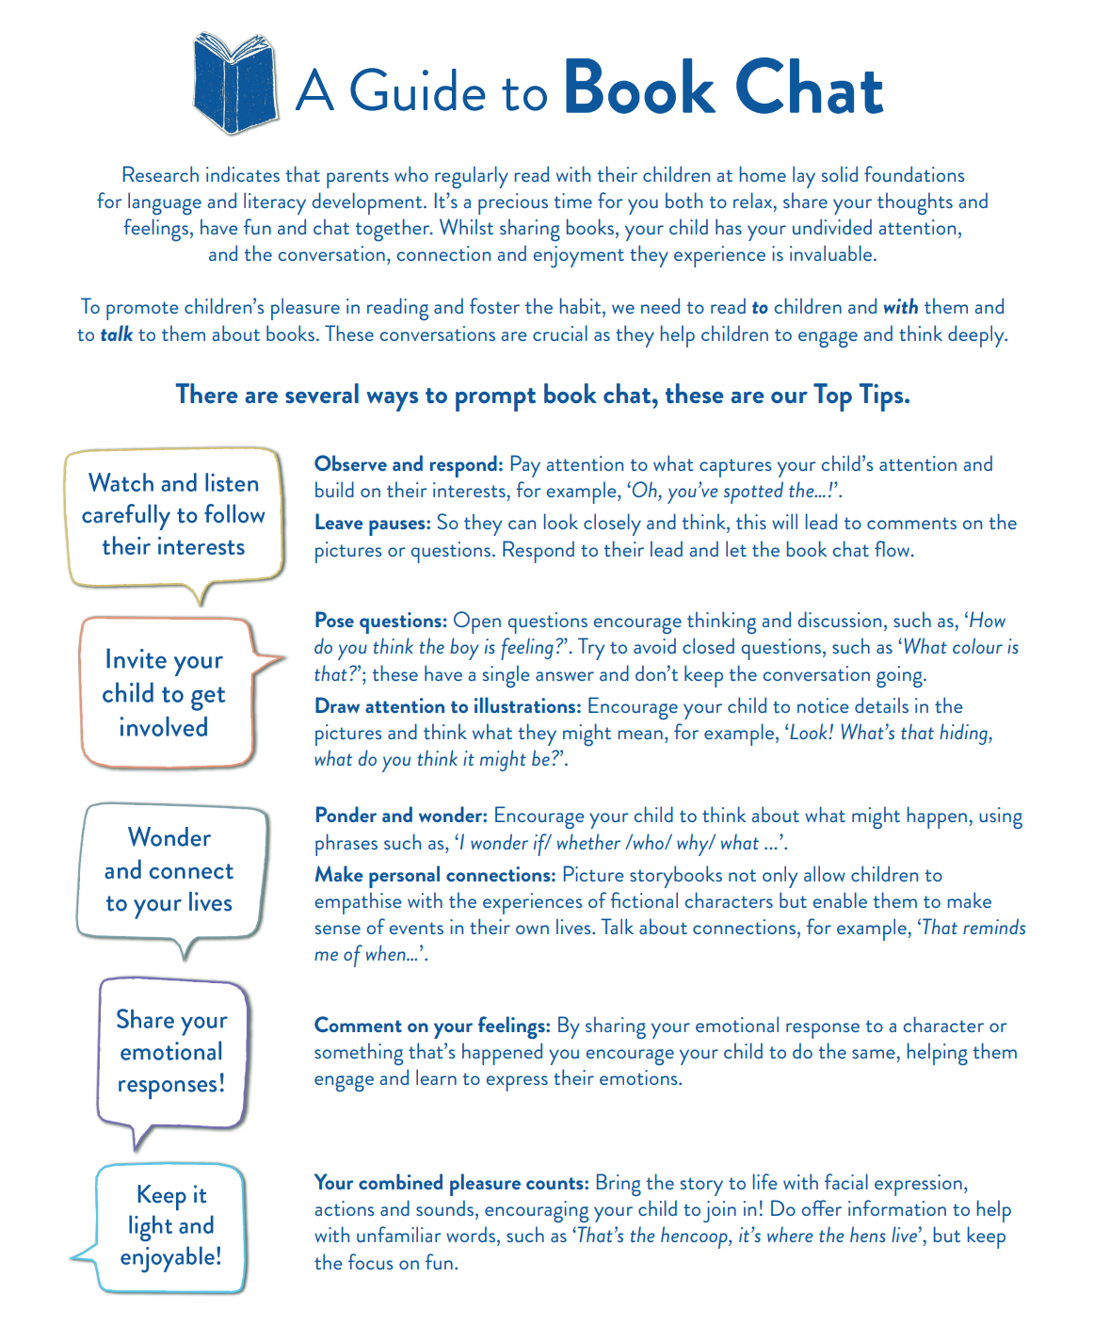
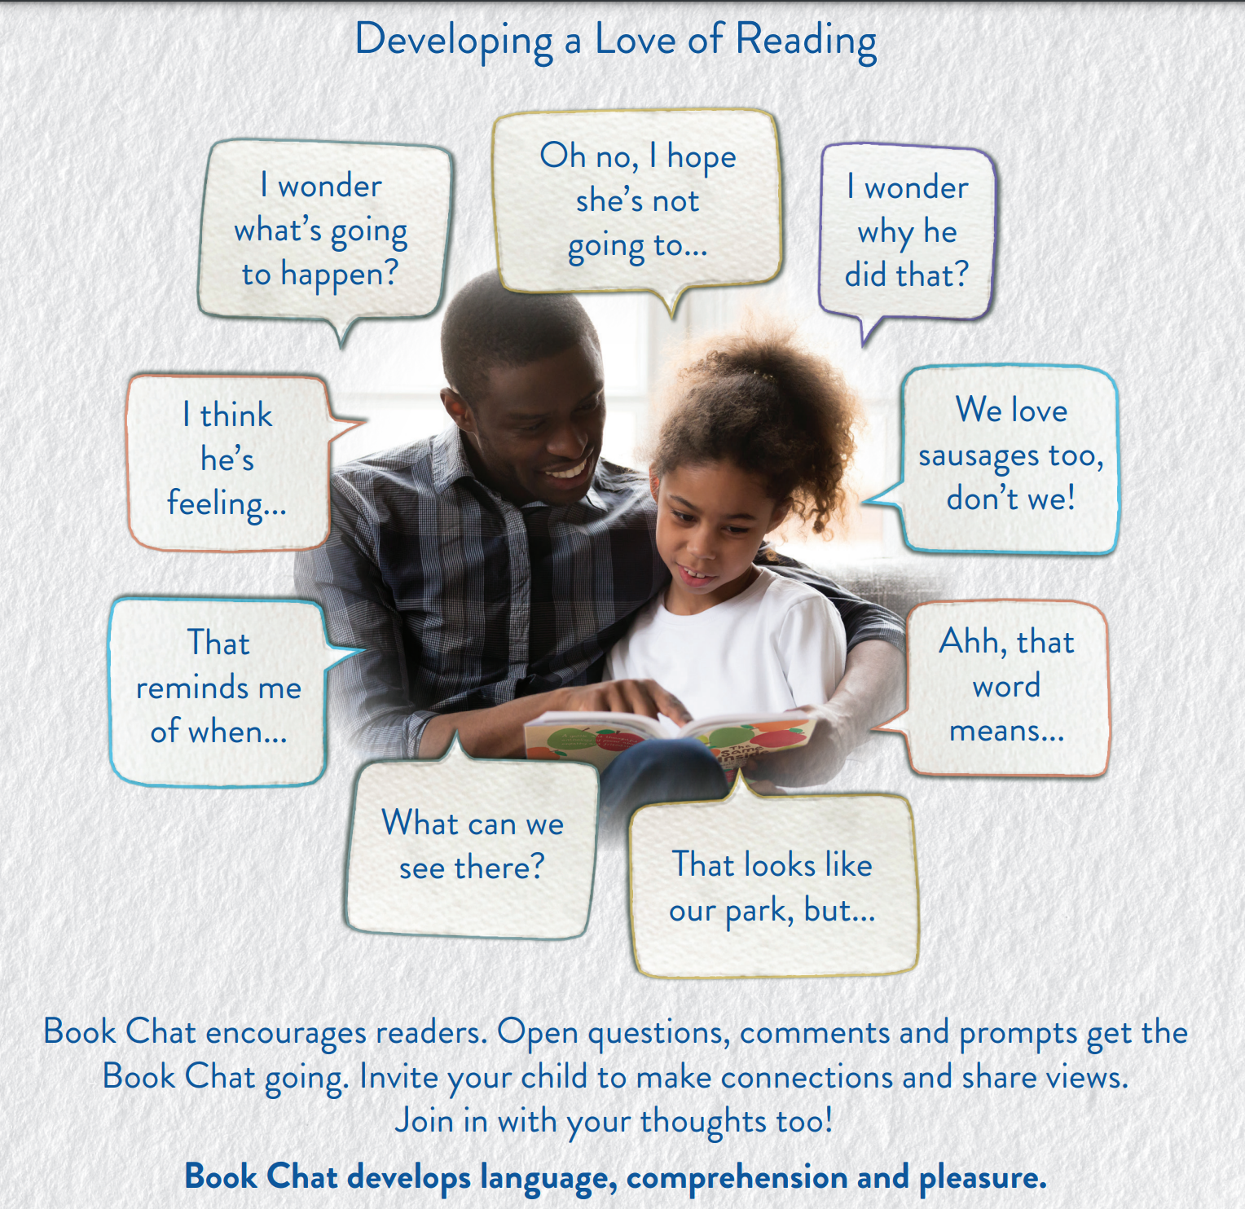
Book chat

Slide 18
Engaging reluctant readers
Read to your child. Make it something special, a time where you bond and spend quality time together.
Choose books linked to their interests.
Older readers might enjoy graphic novels- they may perceive these texts as being less ‘reading’ but still with grown up themes that will appeal.
Try Barrington Stoke books (we have lots in school). These are dyslexia friendly. Shorter than most novels but with themes and stories that will appeal and are written by well-regarded authors.
Try to engage them with non-fiction, age appropriate newspapers and magazines.
Let your child see you reading for pleasure.
Try audio books- you could even try listening to audio books as a family together.
Join the library and visit together. Look through the books and discuss ones that appeal.

Slide 19
Support for parents
These websites are really helpful…
Booktrust
https://www.booktrust.org.uk/books-and-reading/have-some-fun/
Open University Reading for Pleasure at Home
https://ourfp.org/supporting-rah/
The Reader Teacher
https://www.thereaderteacher.com/

Slide 20
Questions?

