Slide 1

Key Stage 2 SATs
A School Presentation to Parents

Slide 2
In this meeting, we will discuss…
An overview of the SATs
The timetable for SATs week
Details on each test paper that the children will sit
Marking of the SATs
Ways to help your child
Time for questions

Slide 3
Previous two years…
This is the first time, in two years, that Year 6 children across the country will be sitting their Year 6 SATs exams.
The results will not be published or link to league tables.
Secondary schools will receive these results, but often assess the children using their own assessments in September.

Slide 4
The tests
Key Stage 2 SATs take place nationally in the week commencing 9th May 2022.
Statutory tests will be administered in the following subjects:
Punctuation, Vocabulary and Grammar (45 minutes)
Spelling (approximately 15 minutes)
Reading (60 minutes)
Mathematics
Paper 1: Arithmetic (30 minutes)
Paper 2: Reasoning 2 (40 minutes)
Paper 3: Reasoning 3 (40 minutes)
All tests are externally marked.
Writing will be teacher assessed internally.

Slide 5
Monday 9th May | Tuesday 10th May | Wednesday 11th May | Thursday 12th May | Friday 13th May
Breakfast Club 8.30am | Breakfast Club 8.30am | Breakfast Club 8.30am | Breakfast Club 8.30am | No Breakfast Club
Grammar, Punctuation and Spelling test (45 minutes for the Punctuation and Grammar test; 15 minutes for the Spelling test) | Reading test (1 hour to read three texts and answer questions) | Mathematics Paper 1: Arithmetic (30 minutes) | Mathematics Paper 3: Reasoning 3 (40 minutes) | Variety of activities which focus on other areas of the curriculum
Playtime | Playtime | Playtime | Playtime | Playtime
 |  | Mathematics Paper 2: Reasoning 2 (40 minutes) |  | Variety of activities which focus on other areas of the curriculum

Slide 6
Grammar, Punctuation and Spelling
A spelling test is administered containing 20 words and will last approximately 15 minutes.
A separate test is given on grammar, punctuation and vocabulary.
This test lasts for 45 minutes and requires short answers including some multiple choice.
Marks for these two tests are added together to give an overall total. 70 marks are available for grammar, punctuation and spelling.

Slide 7
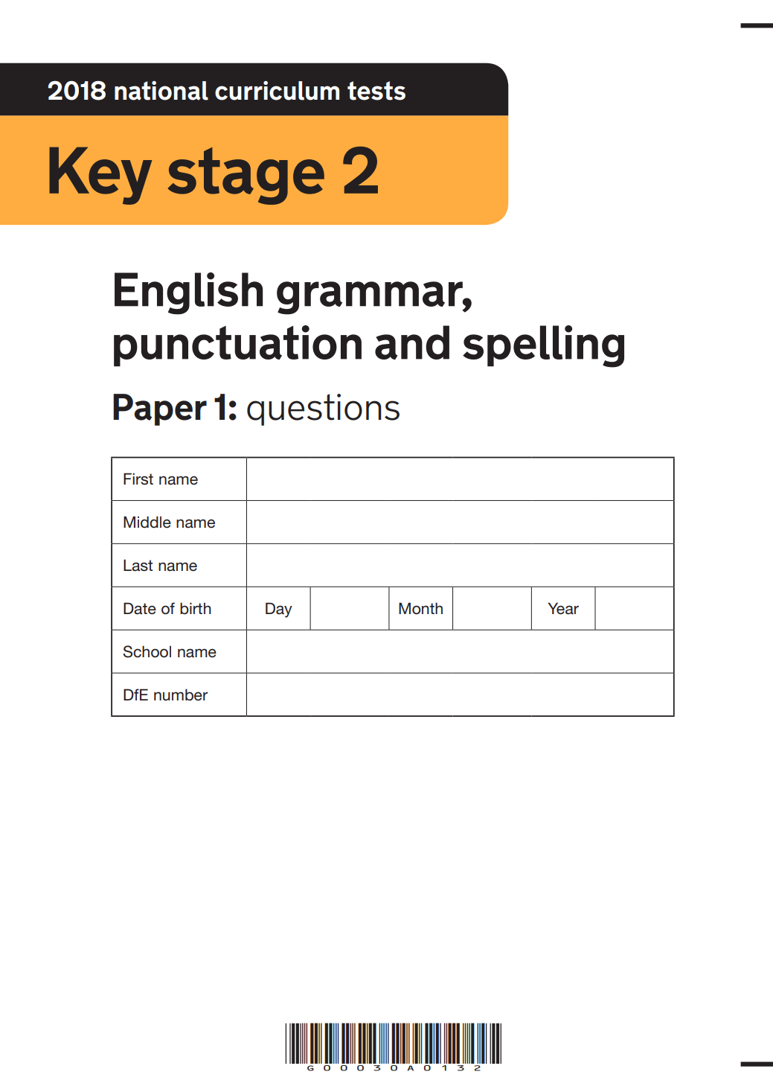
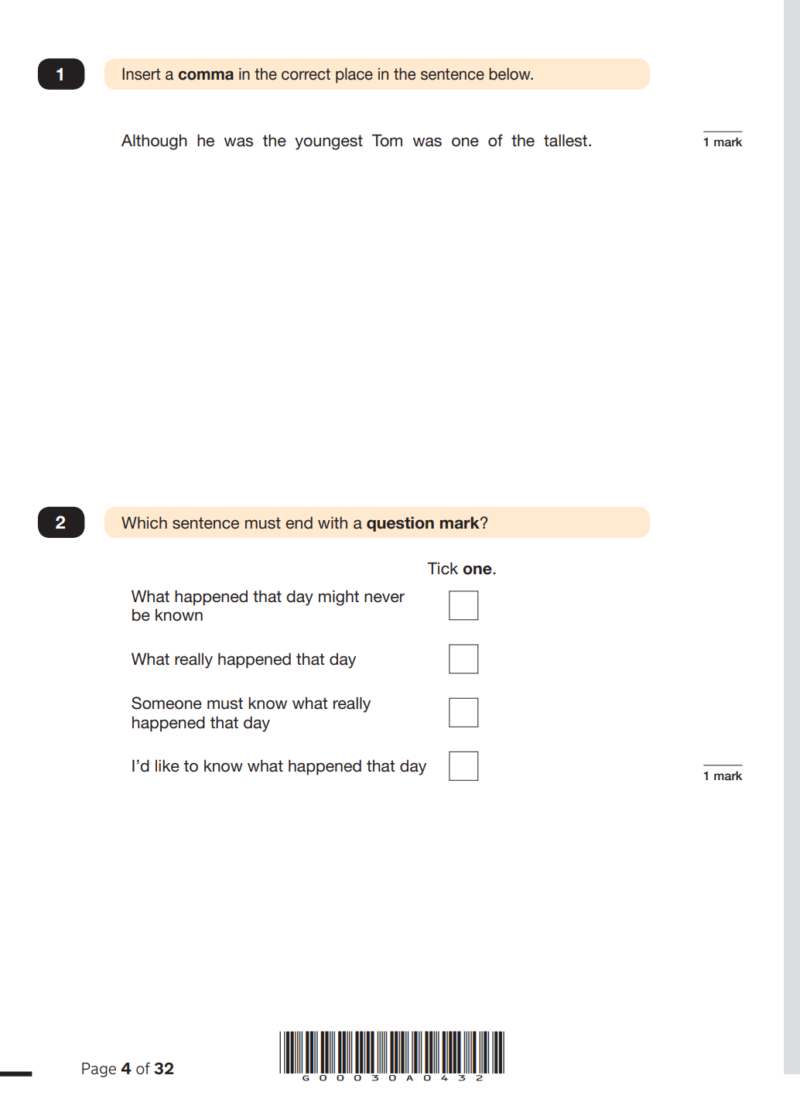

Slide 8
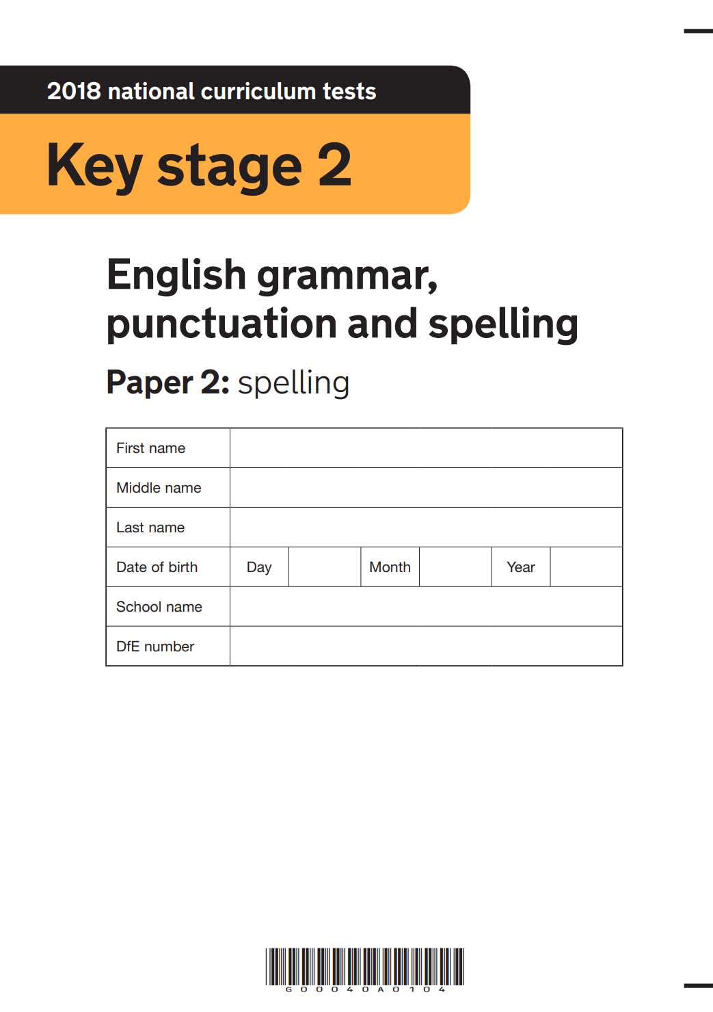
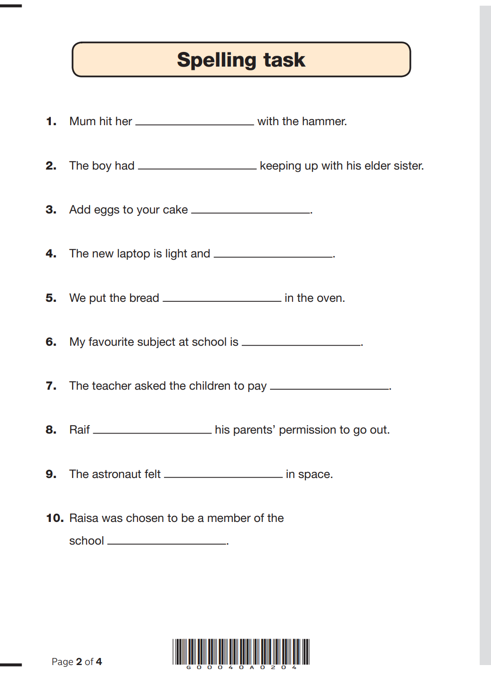

Slide 9
Reading
The reading test consists of a single test paper containing three unrelated reading texts. Children are given 60 minutes in total, which includes reading the texts and answering the questions.
A total of 50 marks are available.
Questions are designed to assess the comprehension and understanding of a child’s reading.
Some questions are multiple choice or selected response; others require short answers and some require a longer response or explanation.

Slide 10


Slide 11
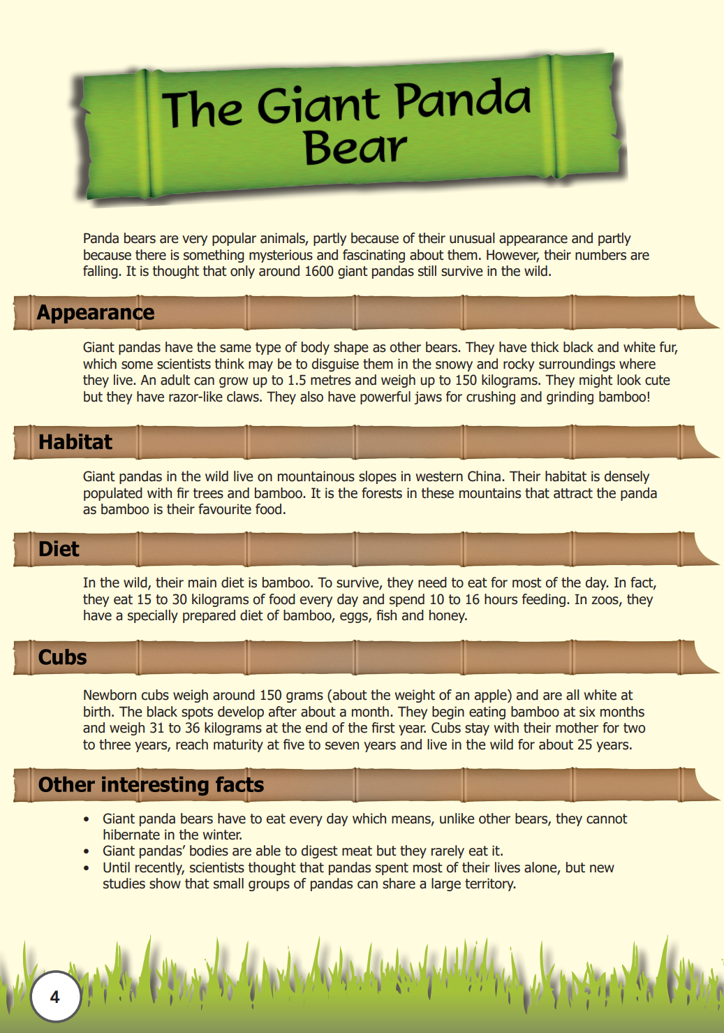
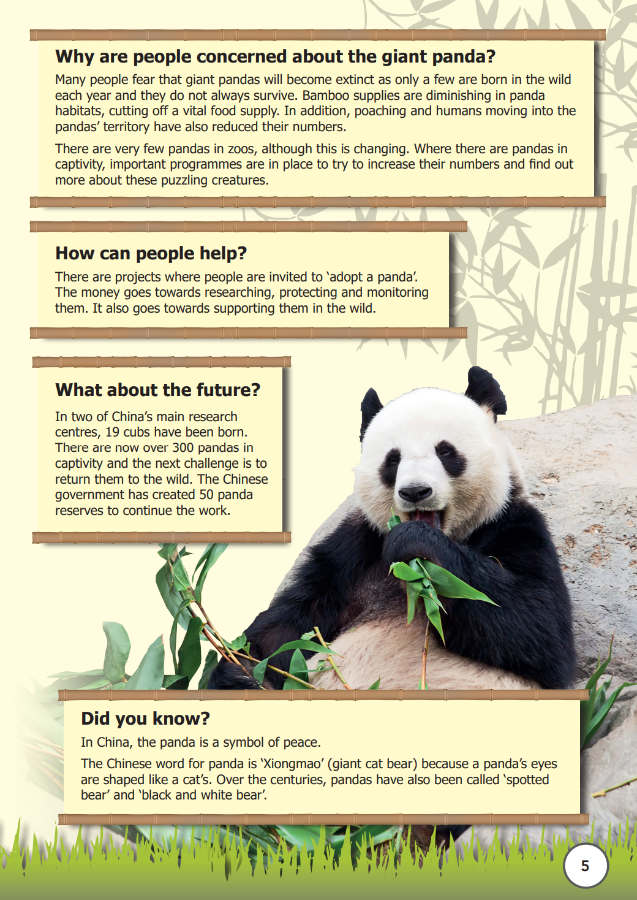

Slide 12
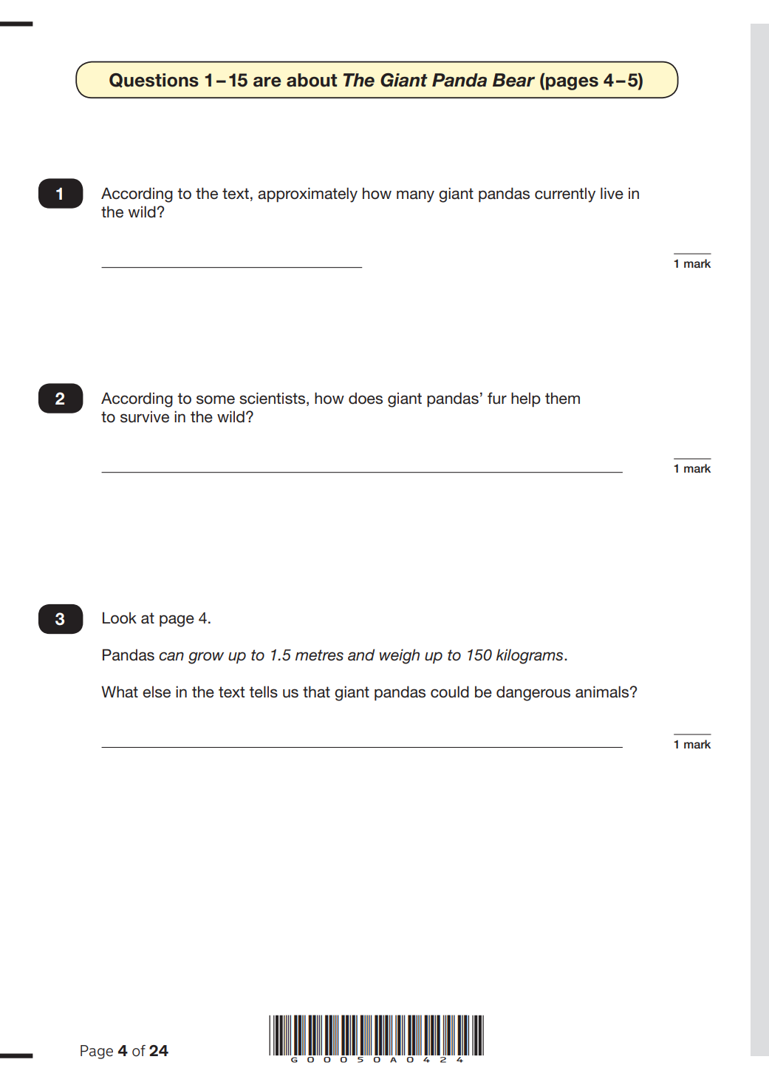
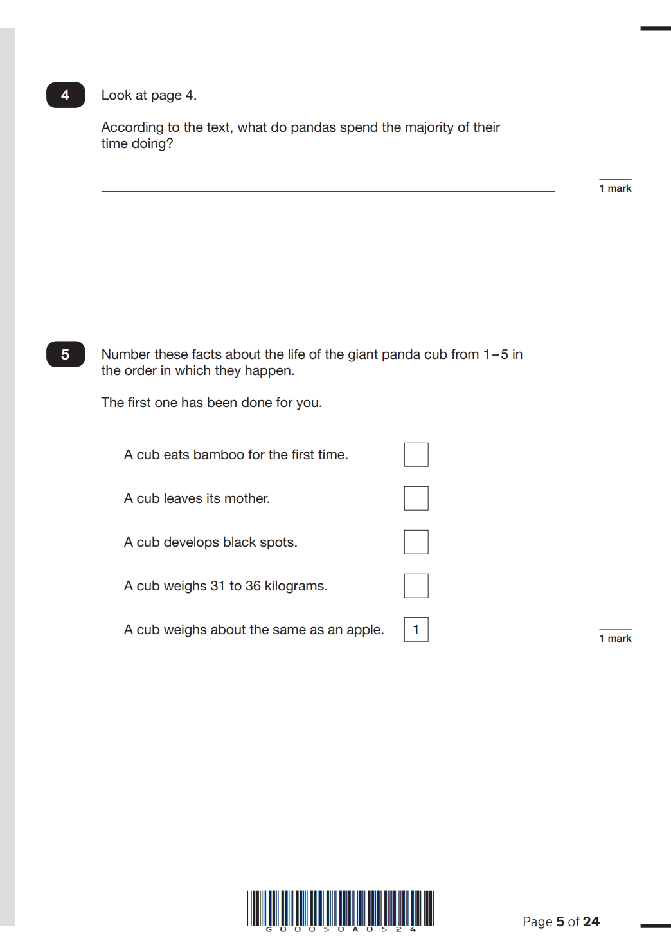

Slide 13
Maths
Children will sit three tests: paper 1, paper 2 and paper 3.
Paper 1 is for arithmetic and lasts 30 minutes. It covers calculation methods for all operations, including the use of fractions, percentages and decimals.
Paper 2 and 3 cover problem solving and reasoning, each lasting for 40 minutes.
Children will still require calculation skills for Paper 2 and 3 but will need to answer questions in context and decide what calculations are required to find a solution.
A total of 110 marks are available (40 for arithmetic and 35 for each reasoning paper).

Slide 14
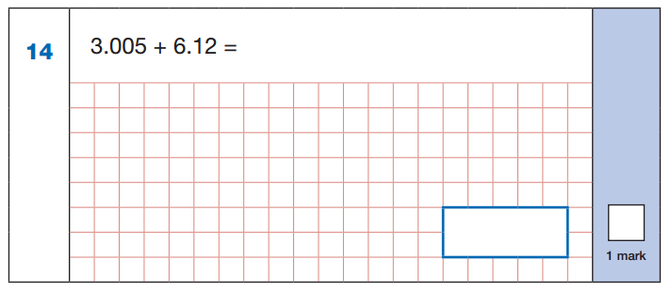
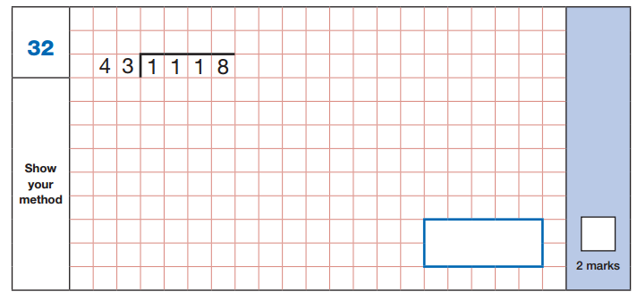
Paper 1: Arithmetic

Slide 15
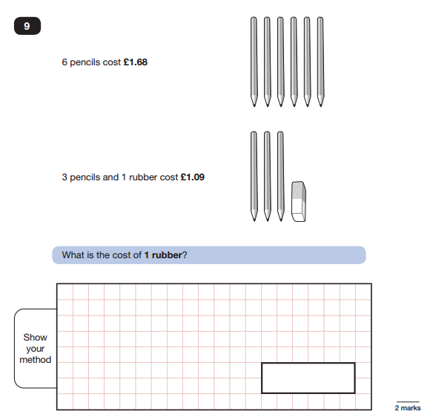
Paper 2 / Paper 3: Reasoning

Slide 16
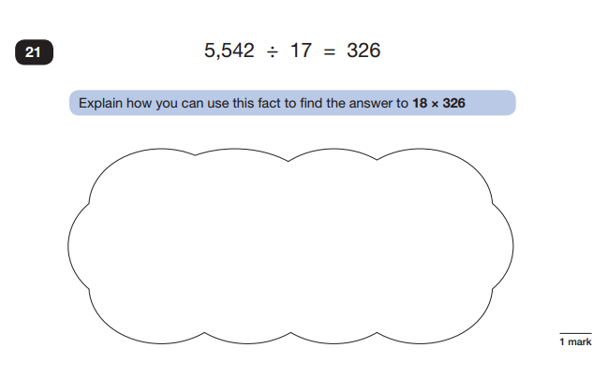
Paper 2 / Paper 3: Reasoning

Slide 17
Special consideration…
If something happens, which could affect the pupil’s performance at the time of the test(s), special consideration could apply.
Please contact Mrs Rawlins or Mr Tull to speak with them directly.
Special arrangements may be put in place for any unforeseen circumstances that take place in the run up or during the week of SATs.

Slide 18
Marking of the SATs papers
All tests are marked externally.
A scaled score of 100 will always represent the ‘national standard’.
Each pupil’s raw score (the number of questions they get correct) will be converted into a score on the scale, either at, above or below 100.
A child who achieves the ‘national standard’ (a score of 100) will be judged to have demonstrated sufficient knowledge in the areas assessed by the tests.
Each pupil receives:
a raw score in each tested subject;
a scaled score in each tested subject;
confirmation of whether or not they attained the national standard.
Writing will be teacher assessed internally.

Slide 19
It is important to remember that SATs only provide a snapshot of a child’s learning.
Each child’s end of year report will also contain the teacher’s assessment of each subject area including reading, writing and maths.

Slide 20
How to help your child
Support and reassure your child that there is nothing to worry about and they should always try their best.
Ensure your child has the best possible attendance at school prior to the tests.
Support your child with any revision they may be set from their study guides.
Reading daily and times tables practice are always good ways to prepare your child.
Make sure your child has a good sleep and healthy breakfast every morning (or take advantage of the breakfast that will be provided free-of-charge each day in school from 8.30am).

Slide 21
Time for questions

