Slide 1
EYFS/ KS1 Reading Workshop
Mrs Griffin (EYFS/ Phonics Lead)
Mrs Dowdall (Assistant Head – KS2 and English Lead)
Mrs Morris (Assistant Head - EYFS & KS1)

Slide 2
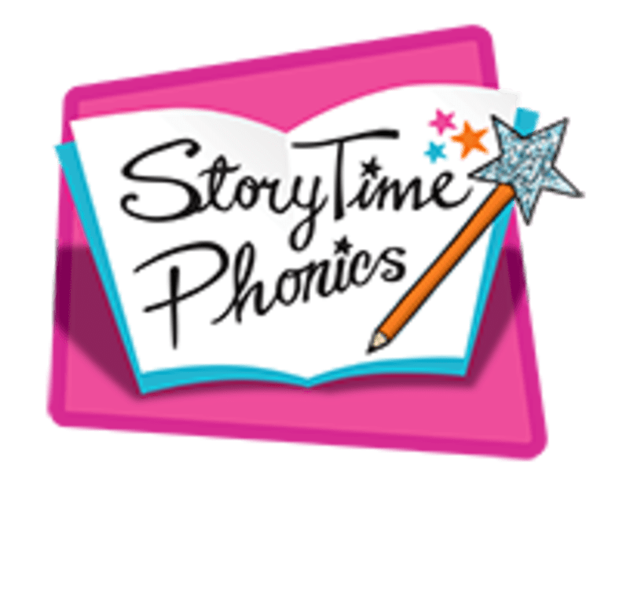
The teaching of phonics at Arbury Primary School

Slide 3
Word Reading
We teach phonics using the StoryTime Phonics scheme.
In phonics, the children learn the sounds that letters make e.g. s says ‘sss’ – careful not to add extra sounds on the end – not ‘suh’
To read words, children learn to sound out a word and then blend the letters to make the word e.g. s-i-t = sit
To write words, children learn to say the word and segment it to find out which sounds are in the word e.g. tap = t-a-p
In the reception year, the children will begin to meet digraphs/ trigraphs where two/three letters make one sound e.g. ai, or, ow.
In Year 1, we meet more digraph and trigraph (2 & 3 letter) sounds e.g. ai, ie, i_e
The children will also learn about alternative graphemes e.g. the long a sound can be written as ai, ay, a_e

Slide 4
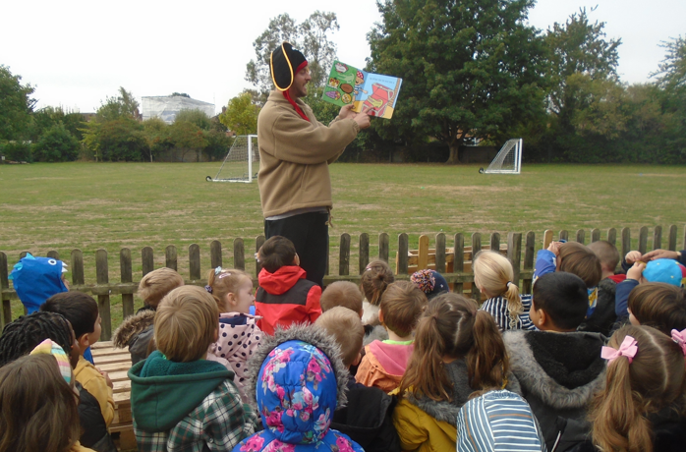

Slide 5
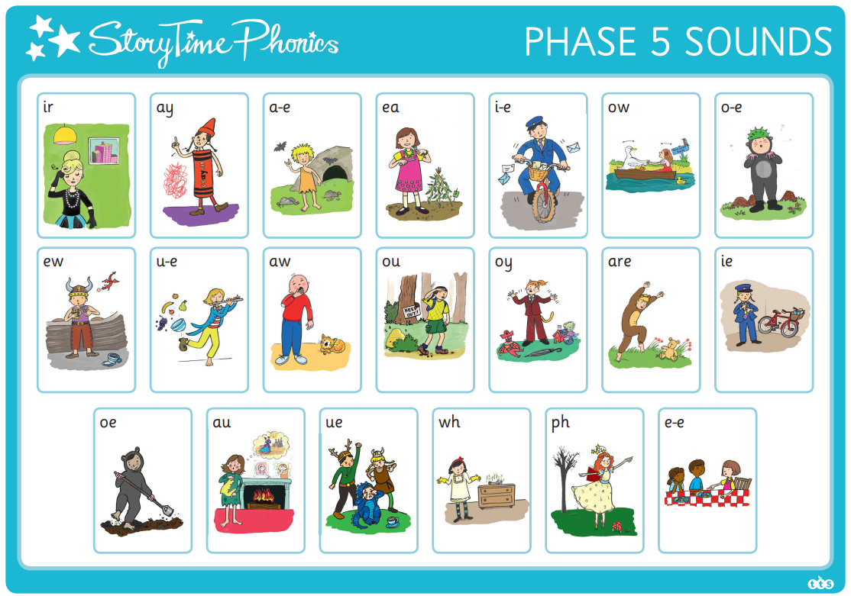
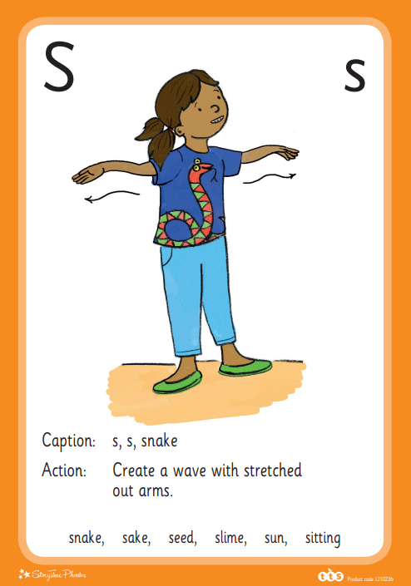
Overview of Sounds
You can watch videos of all of the sounds and actions on the school website. Let’s look at some key resources.

Slide 6
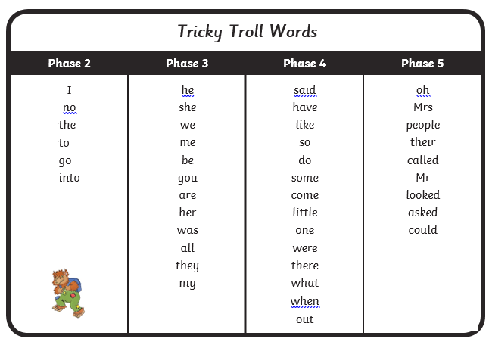
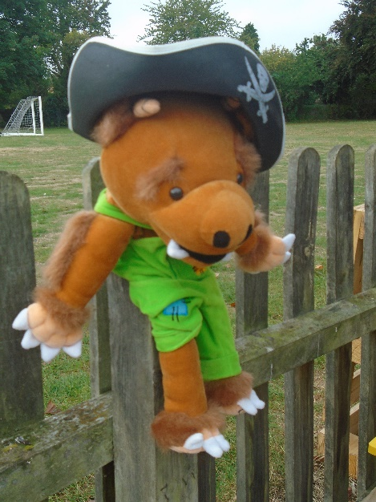
Tricky Troll Words
There are some words for which phonics does not “work” and we learn these as ‘Tricky Troll words’.

Slide 7
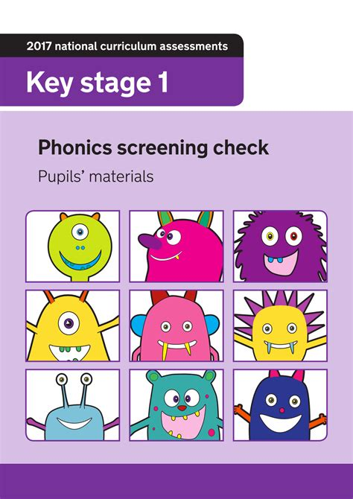
Phonics Screening Check- Year 1
During the summer term, children will take the phonics screening check
It is a short check of your child’s phonics knowledge which is completed by your child’s teacher in a friendly and relaxed atmosphere
There are real words and ‘non-words’ (which we call Beegu words). Beegu words are included to ensure that we are assessing their decoding skills.
You will be told how your child gets on. If your child does not meet the pass mark, they will receive additional support and will retake the check in Year 2.

Slide 8
Reading scheme books
We send home a reading scheme book twice each week to help your children practise with you at home.
These books are fully decodable – apart from the tricky troll words! Your child will bring a book which will be aligned with their individual phonic level.
We suggest you read it (at least!) three times.
Let’s have a look at how we might read a book together.

Slide 9
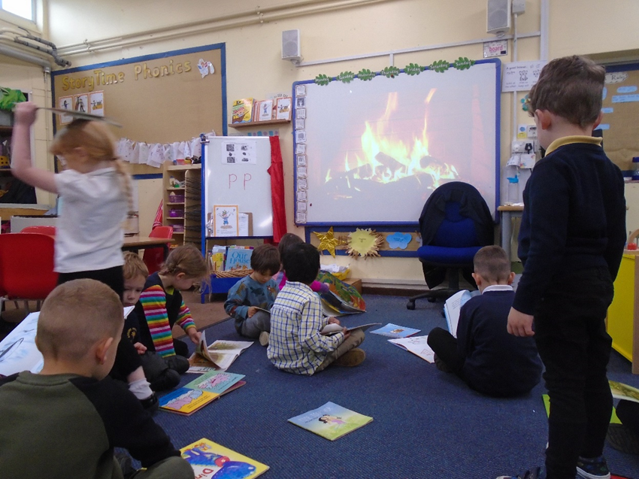
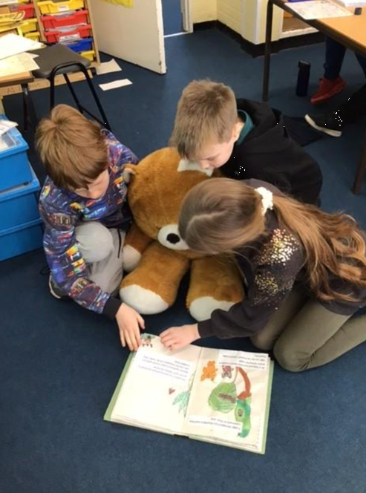
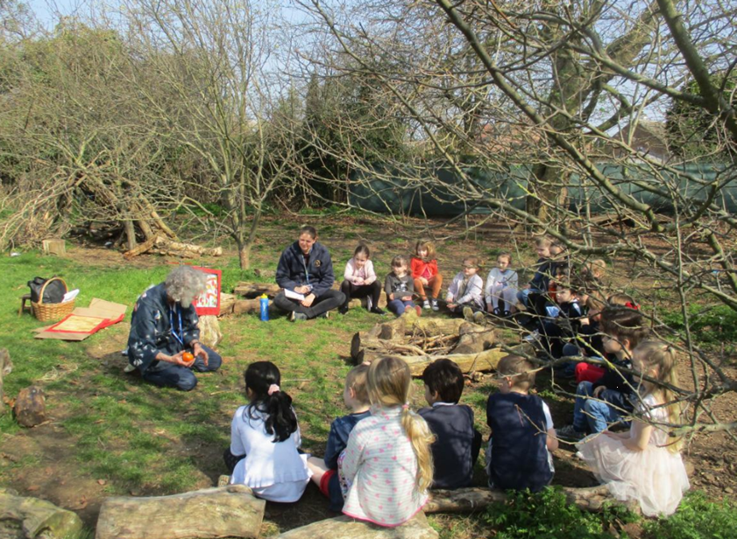
Developing Comprehension and fostering Reading for Pleasure at Arbury Primary School

Slide 10
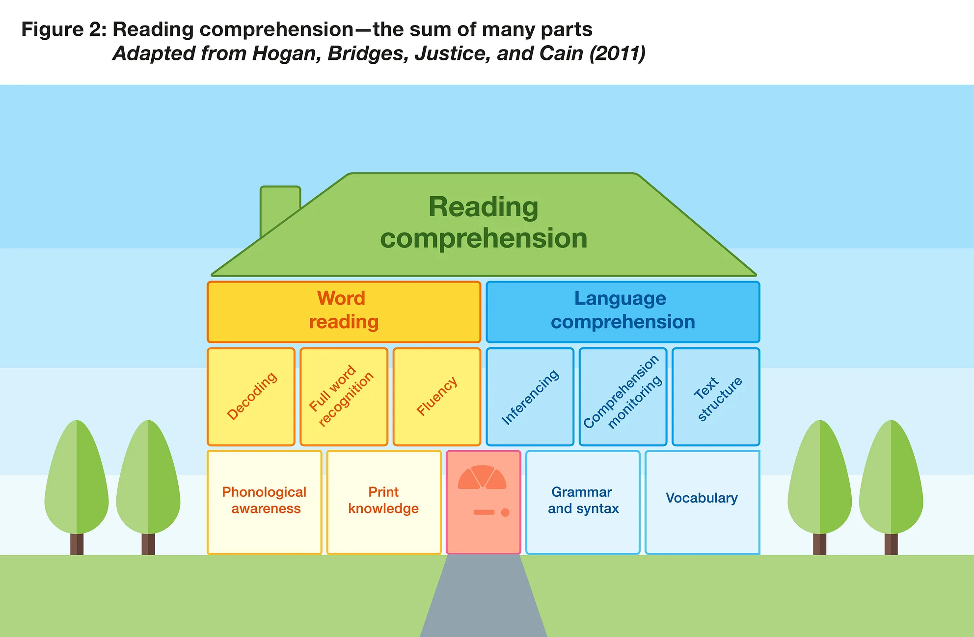
Comprehension- understanding what you read. Alongside teaching phonics, we also develop children’s comprehension skills.

Slide 11
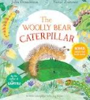
Whole Class Guided Reading from Reception
Use of high quality texts that have been chosen carefully
These more formal reading sessions happen twice a week
Questions are planned carefully to help develop children’s comprehension skills
A session could consist of pre-teaching some key vocabulary, sequencing texts (or retelling, perhaps using puppets), making predictions and getting children to answer retrieval or inference type questions.
Now and again (Year 1) the children may be asked to record their ideas and answers in written form but mainly these sessions consist of carefully planned questions and lots of opportunity for rich discussion.

Slide 12
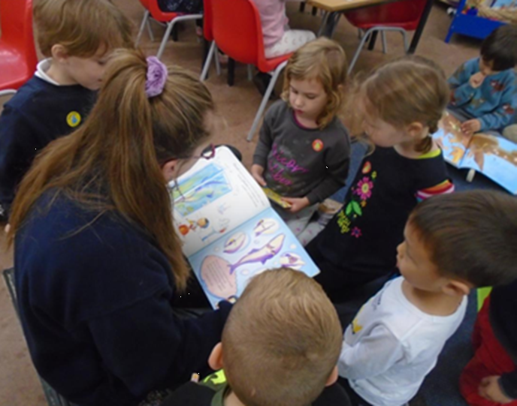
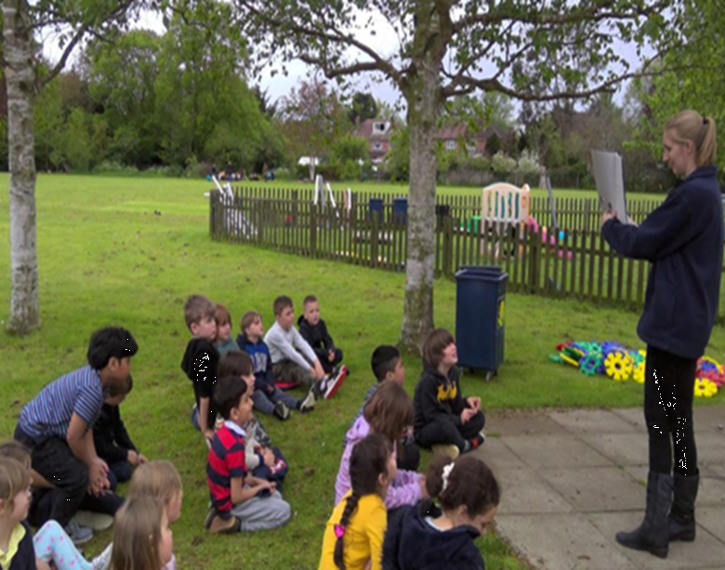
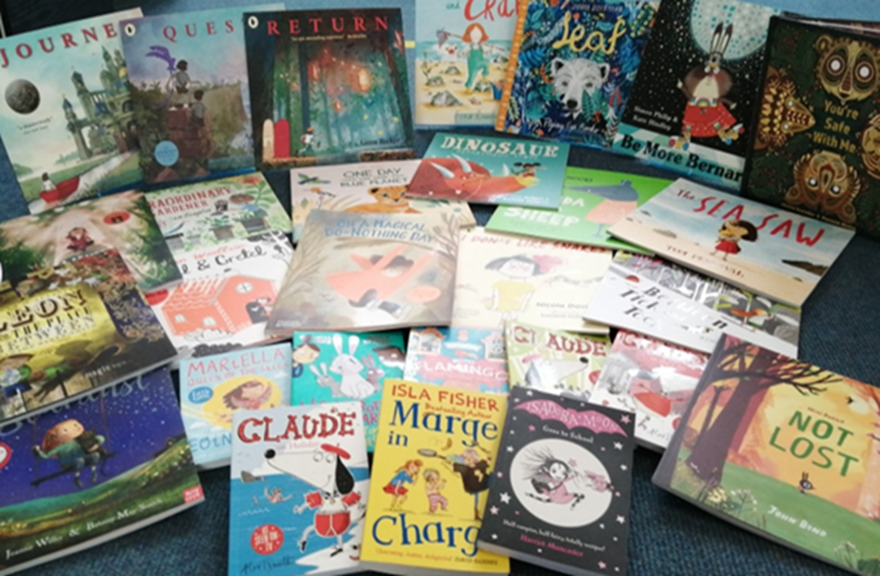
Daily story time
We ensure that there is at least one daily story time in Year 1. This is timetabled in to ensure it is prioritised during the school day.
In Reception, teachers aim to complete ‘5 a day’! This means story time happens regularly throughout the day and they aim for 5 books to be shared.
Reception and Year 1 also have a carefully chosen list of songs and rhymes that they learn across the year.

Slide 13
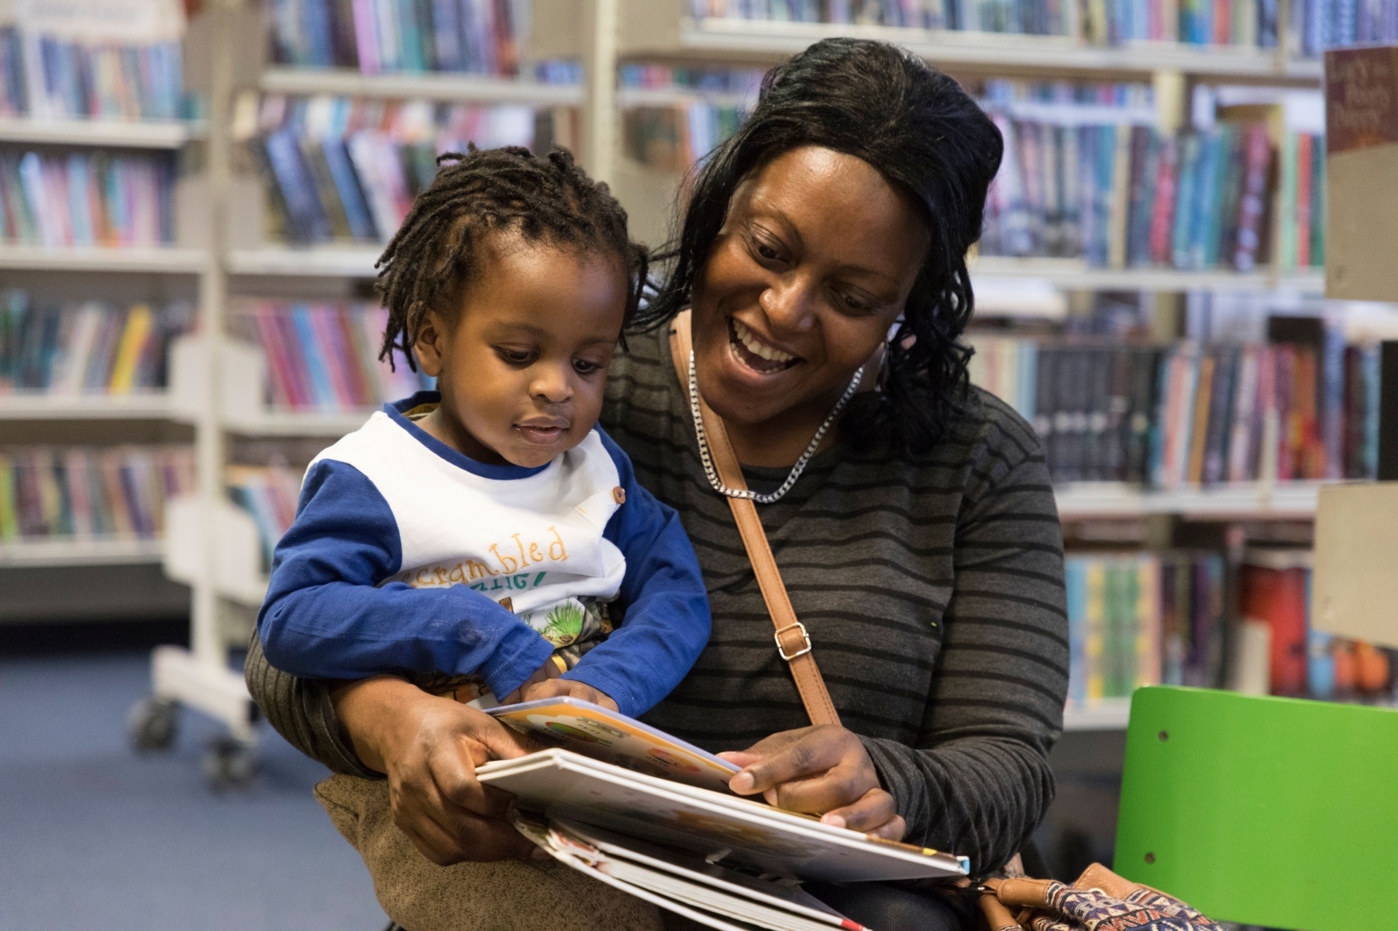
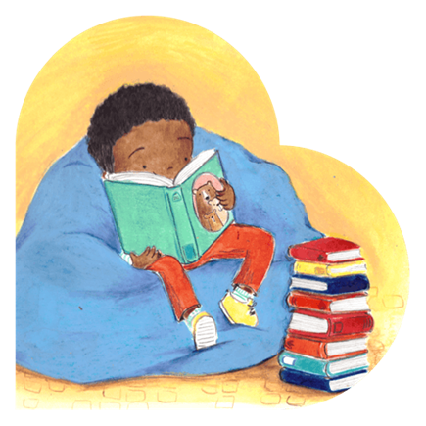
Sharing books that come home
Your children will bring a ‘sharing book’ home in their book bag. They are allowed to change their sharing book as often as they like and we encourage them to do so daily. The children will be encouraged to choose a book that appeals to them from the class book corner.
Sharing books are different from the phonetically, banded book your child will bring home.
We would expect parents to read this book to their child and enjoy it with them (they are unlikely to be able to read this book independently).
Reading regularly to your child helps to widen their vocabulary, develop comprehension skills, improve wellbeing and is a lovely way to bond!

Slide 14
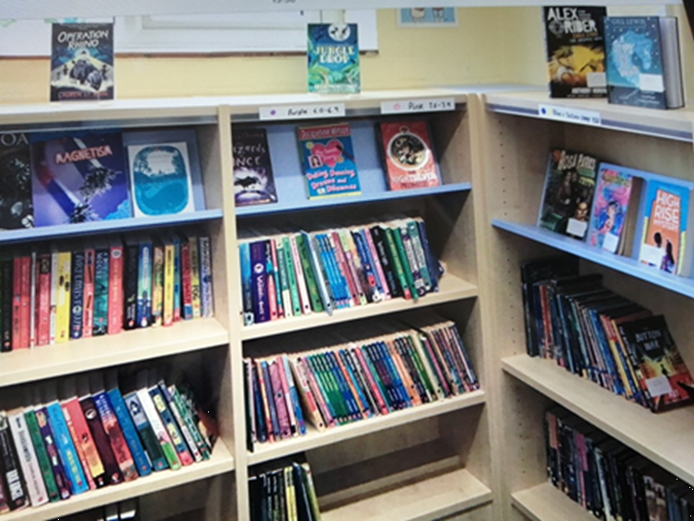
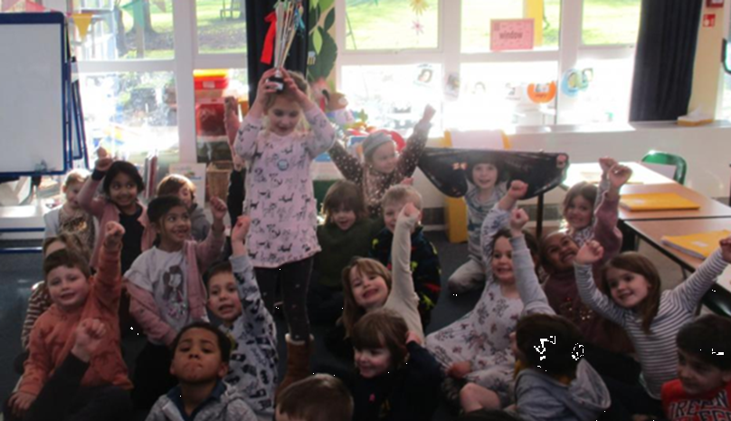
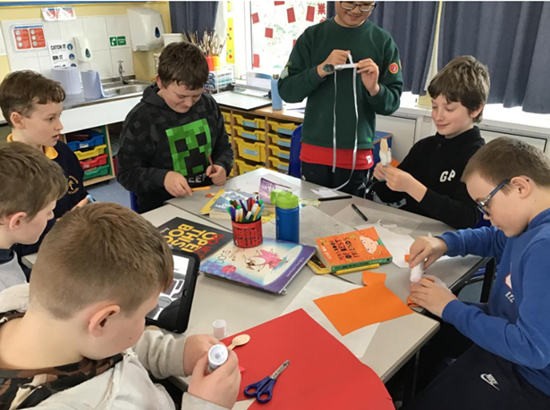
Reading for Pleasure in the wider school
We are dedicated to fostering a Reading for Pleasure ethos in our school and do various things across the whole school to promote it. (E.G. National Poetry Day, World Book Day, DEAR Day etc).
Every class has elected Reading Ambassadors who help keep their class book areas tidy, are book buddies in the KS1 playground and help with Reading for Pleasure events around the school.
A half termly Reading for Pleasure newsletter is sent out with reviews and recommendations from the children and other reading news from school.
We spend lots of the English budget buying books to keep our book stock up to date and relevant.
Our entire English and reading curriculum is based around quality texts.

