Slide 1
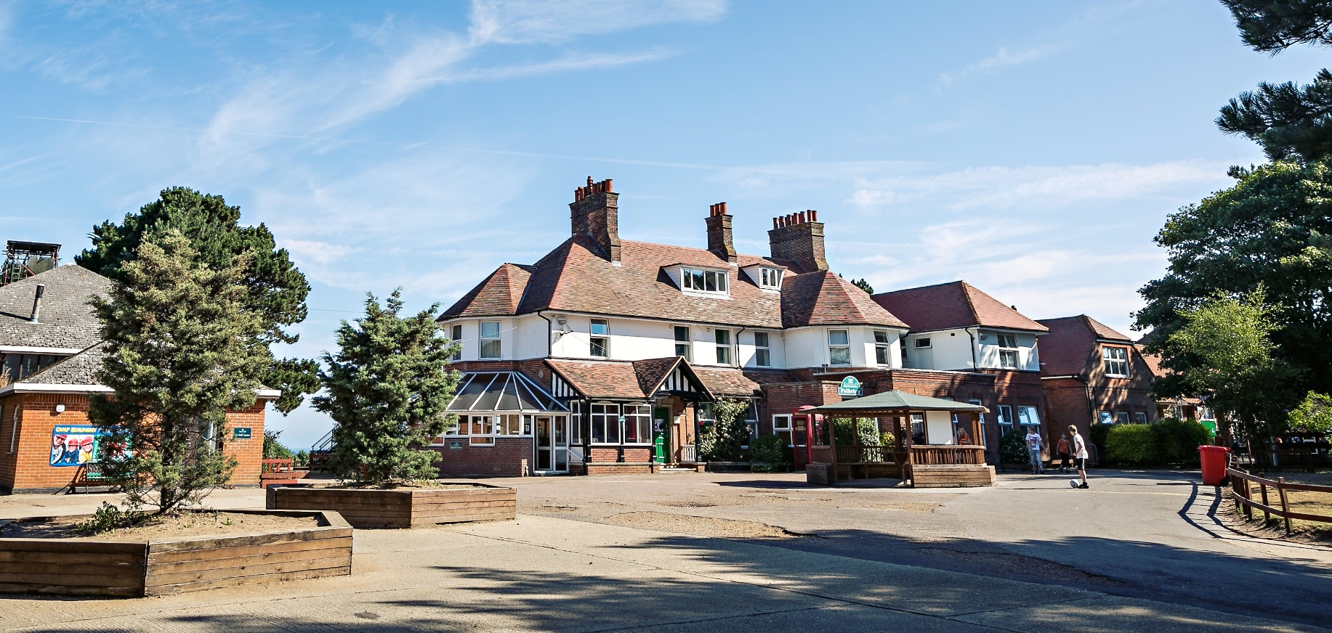
Year 6 Residential Trip
Kingswood 2023
West Runton, N Norfolk.
Wednesday 11th – Friday 13th October 2023

Slide 2
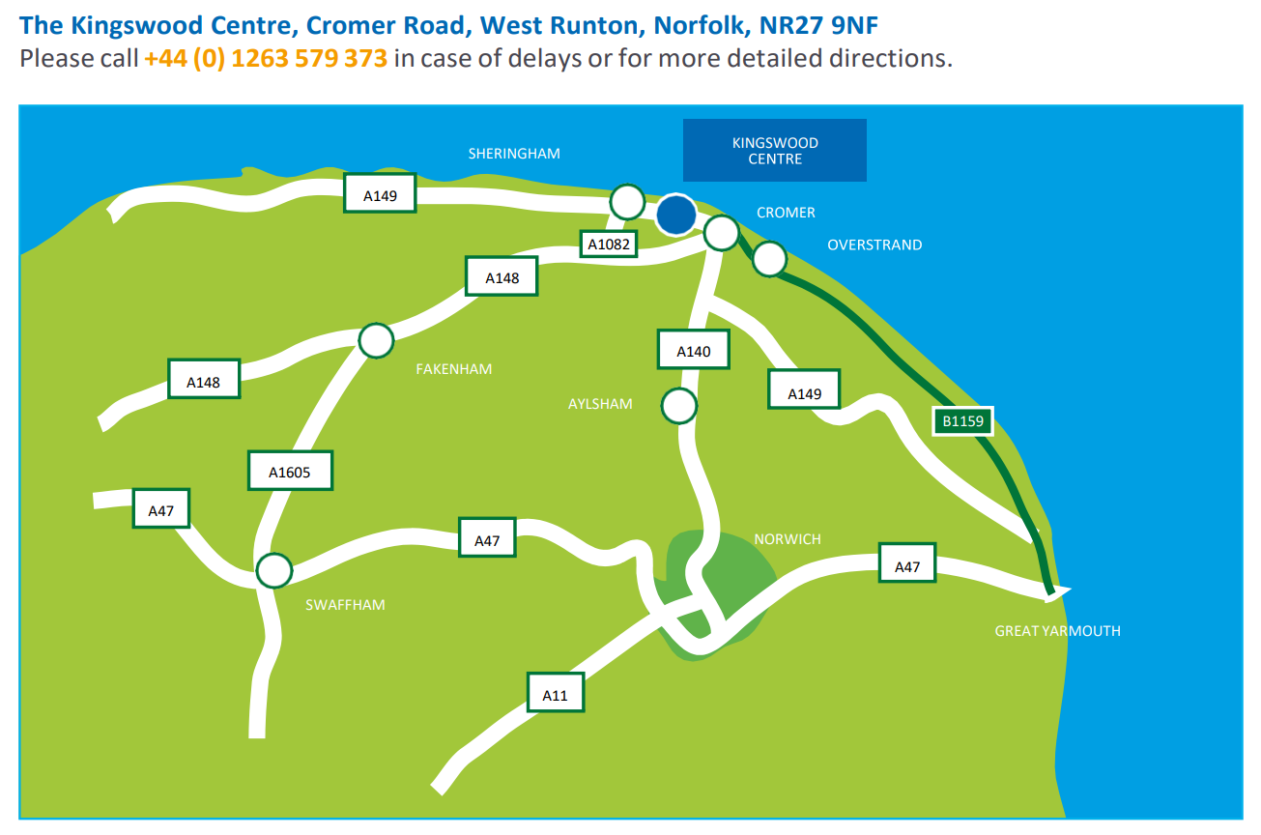
We will travel by coach to and from Kingswood.
The journey will take just under 2 hours.

Slide 3
Adults attending this trip:
Y6 teaching staff and TAs. Sometimes we take TAs from other year groups too, in order to ensure we have enough staff for the trip to run smoothly.
All activities are carried out by trained Kingswood staff. Members of Arbury staff will be on hand to support and encourage pupils to have a go but will not lead the activities themselves. We will also be there to chat to if there are some activities you’d rather not take part in.

Slide 4
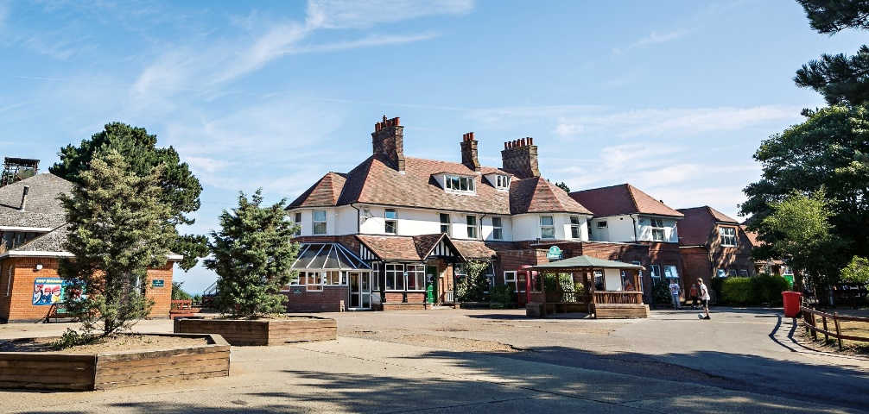
Arriving at Kingswood
When we arrive at Kingswood, the children will meet the course director and the outline for the week will be explained. They will also give you a tour so you know where to go and when. It’s a small (but lovely) site so please don’t worry!
Children will have their lunch, see their rooms and get ready for their first activity of the day.

Slide 5
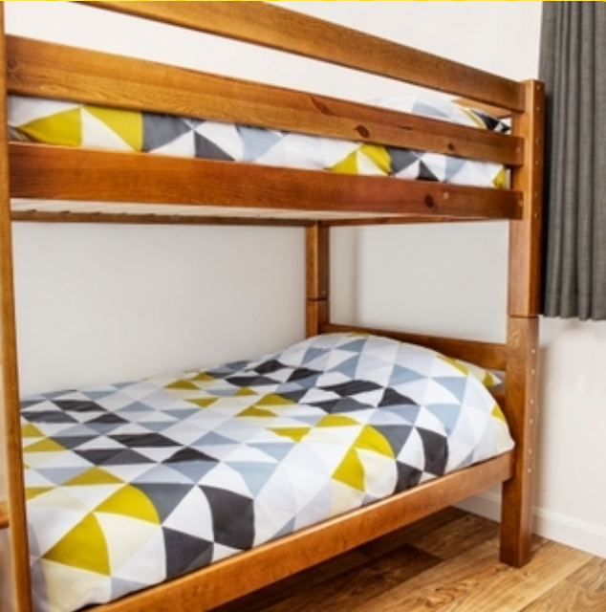
Rooms and accommodation
Children will sleep in dormitories. These are split into separate accommodation areas for girls and boys, each with their own separate facilities.
In September, children will be asked to write down 2-3 children that they would like to be in a room with.
We will do our best to ensure all children are in a room with at least 1 of their friends.

Slide 6
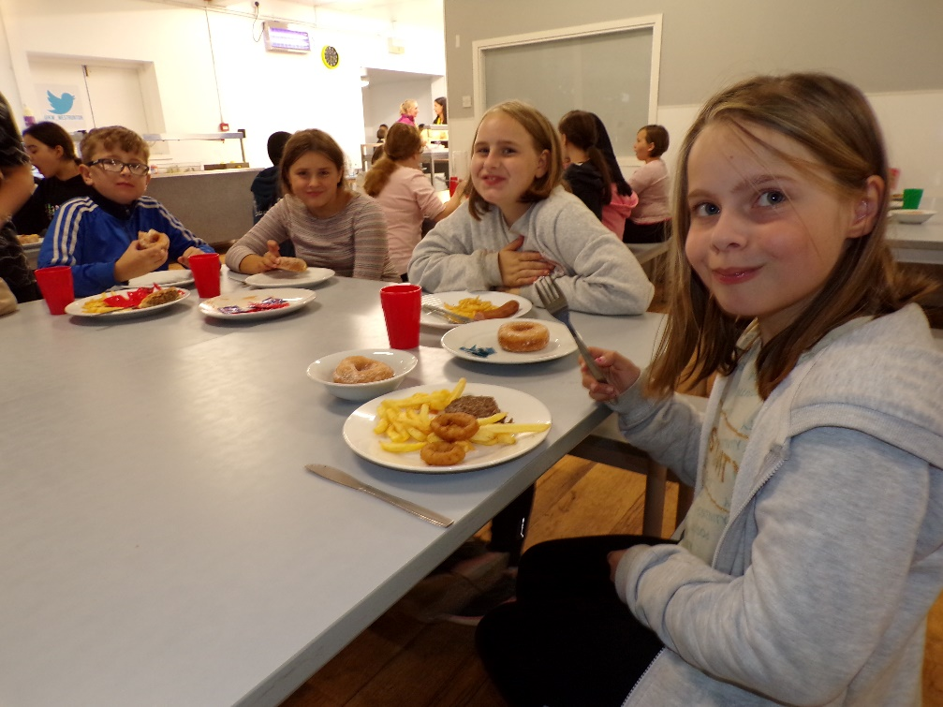
Food while away at Kingswood
Kingswood will provide children with three meals a day. There is plenty of choice and food! Please do not send additional snacks with your child.
Dietary forms will be provided to ensure your child’s needs are catered for.

Slide 7
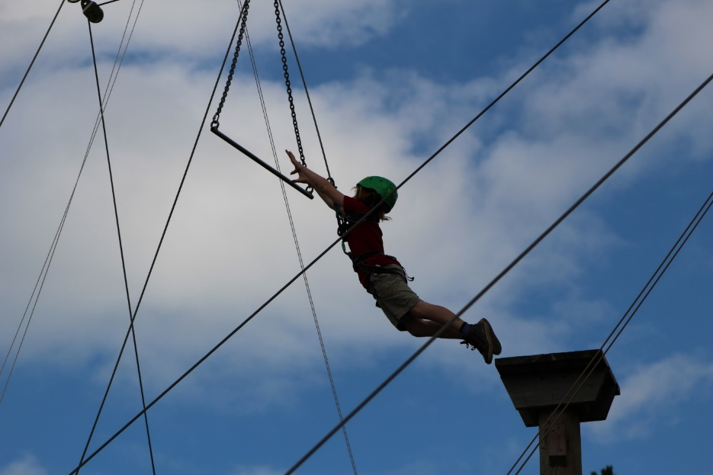
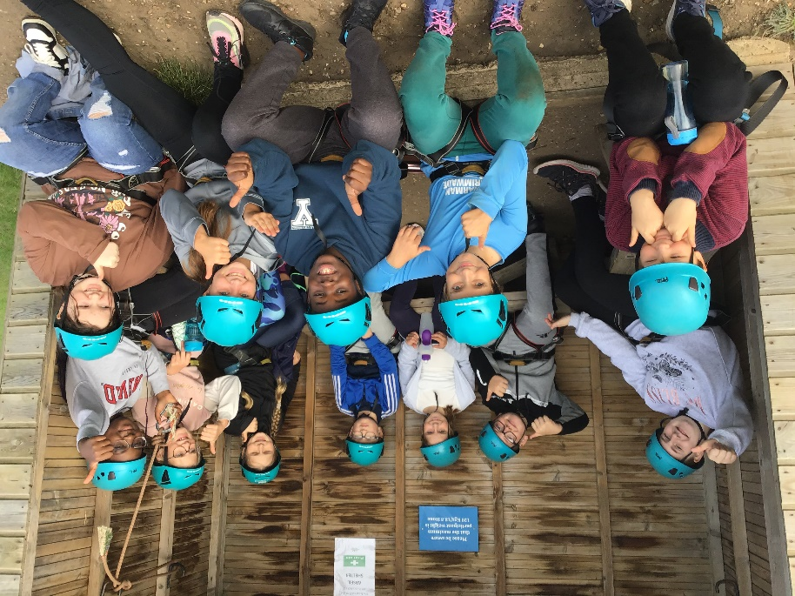
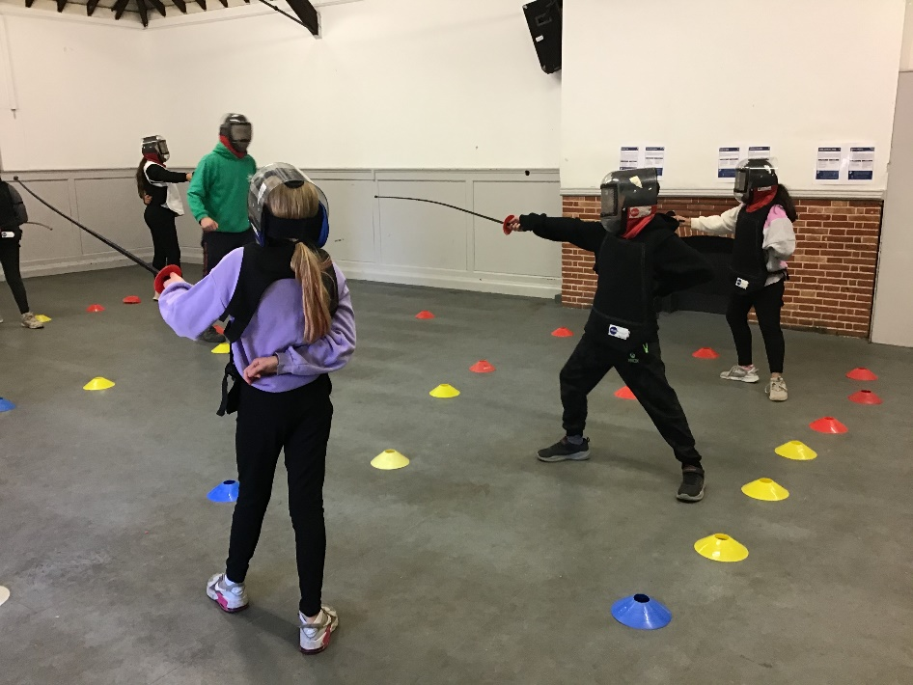
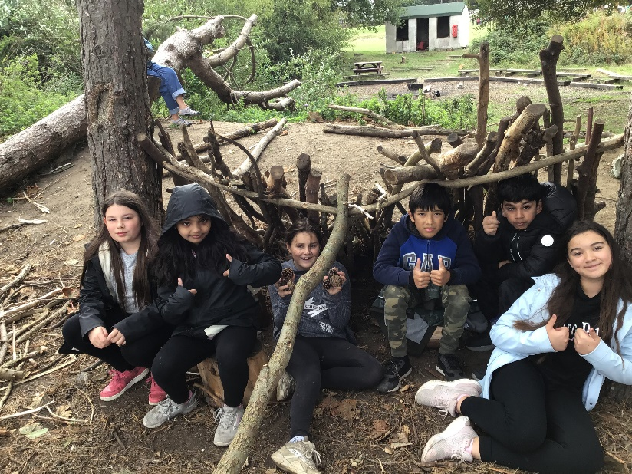
Confidence
Resilience
Life skills

Slide 8
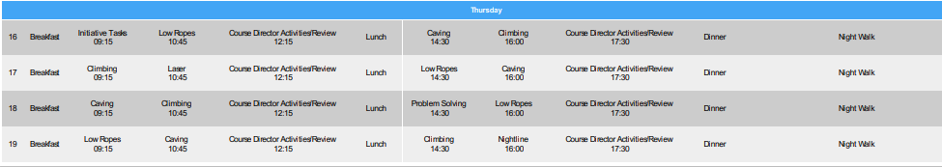
Example timetable at Kingswood..
These will be followed by an evening activity, such as a disco. Other activities include: a beach visit, team games, abseiling, shelter building and loads more!

Slide 9
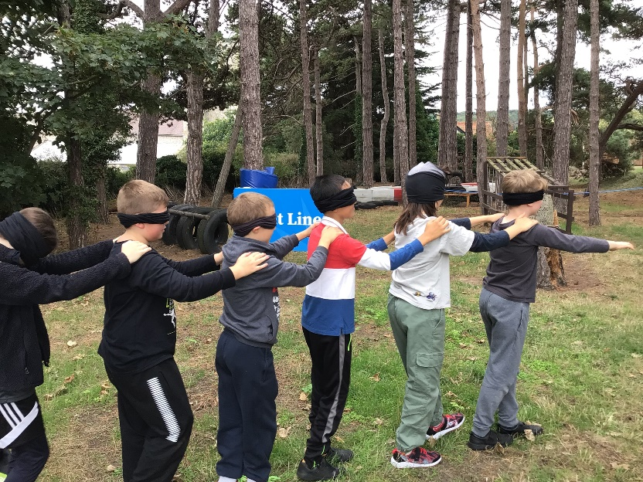
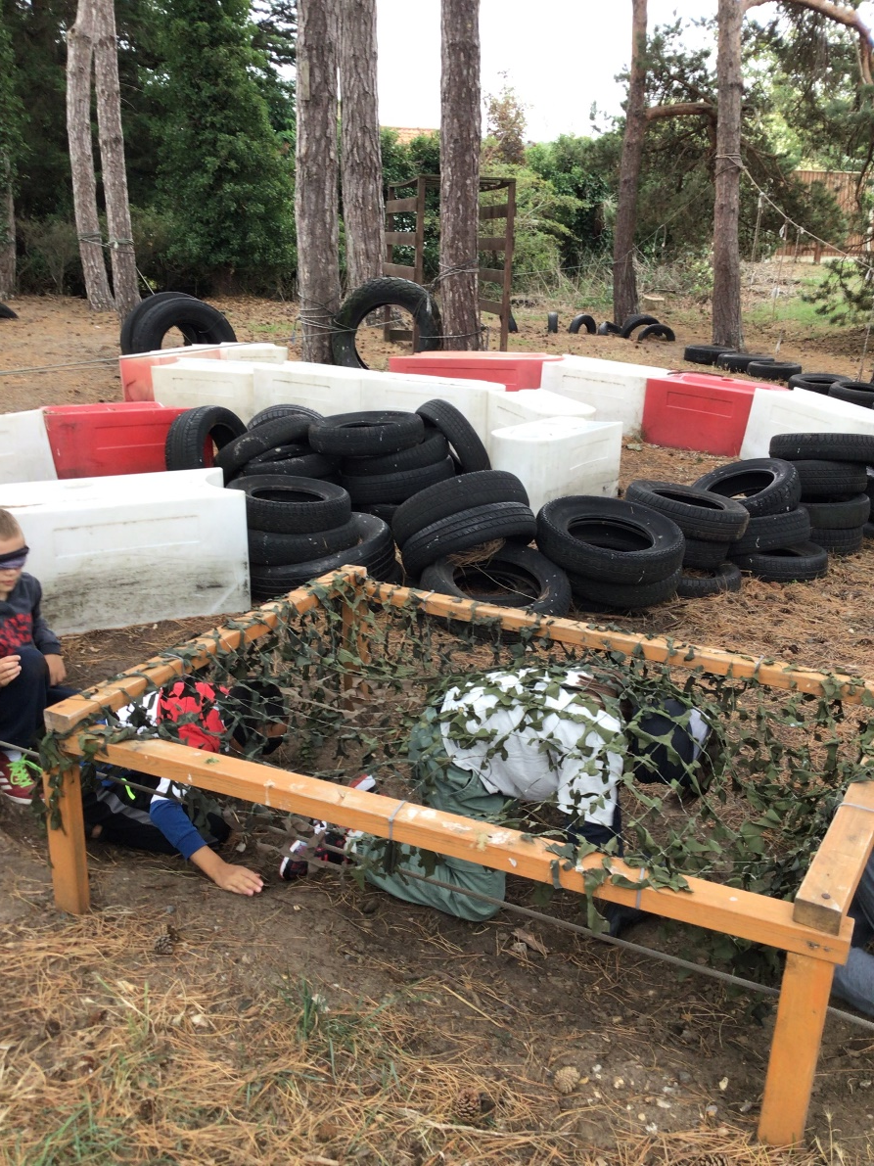
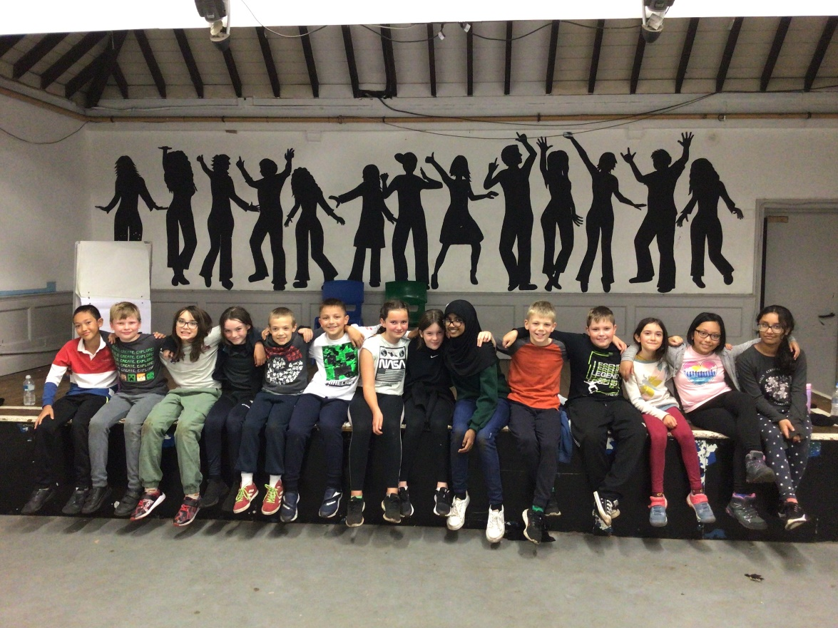
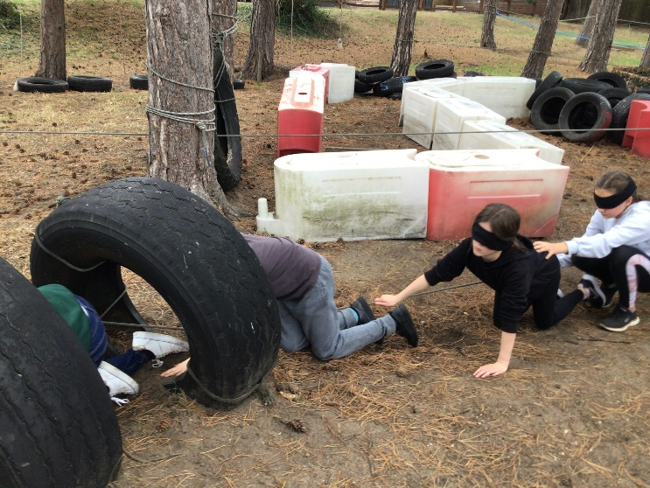
Take a look at some pictures from previous trips!

Slide 10
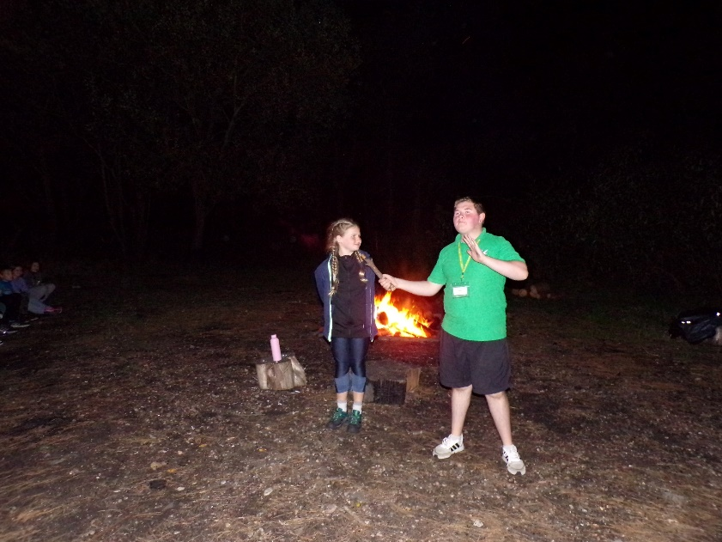
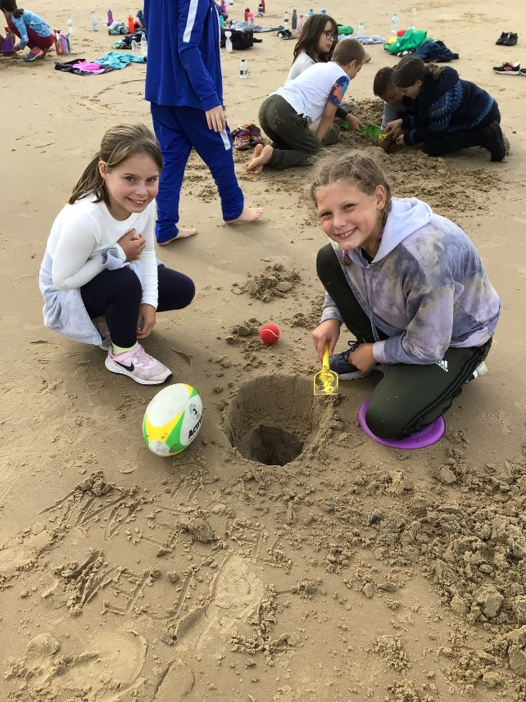
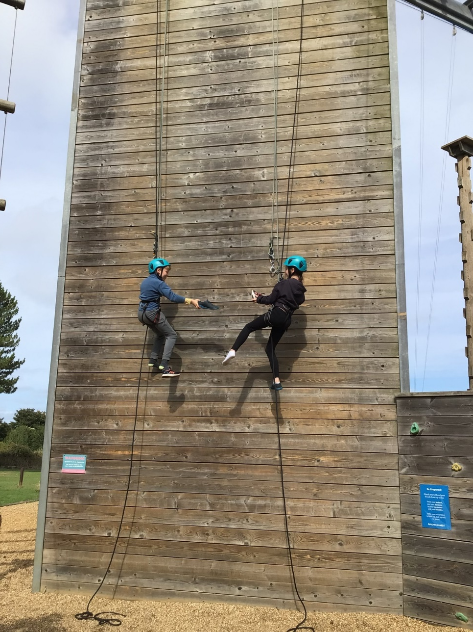
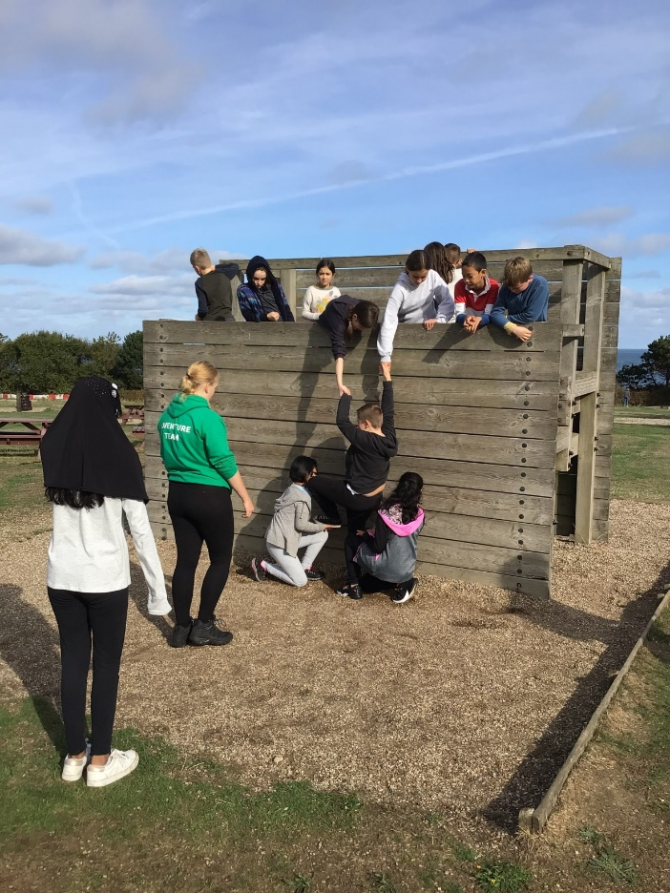
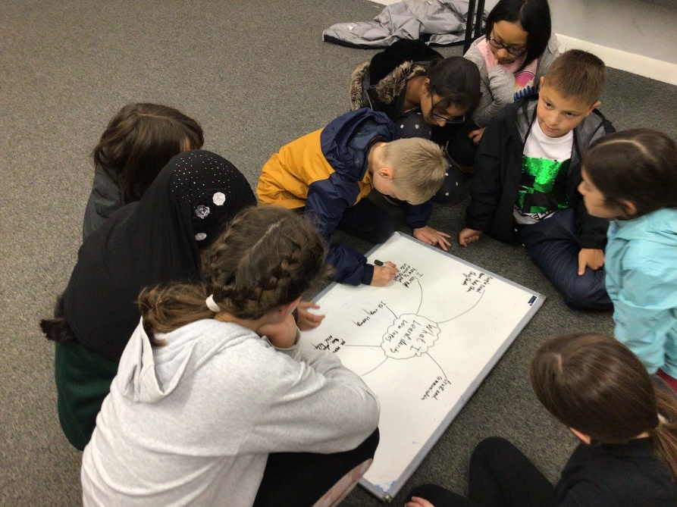

Slide 11
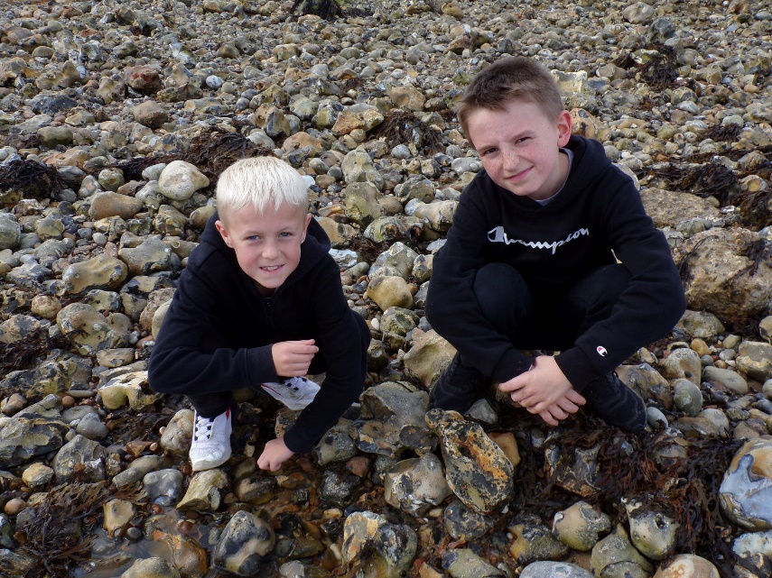
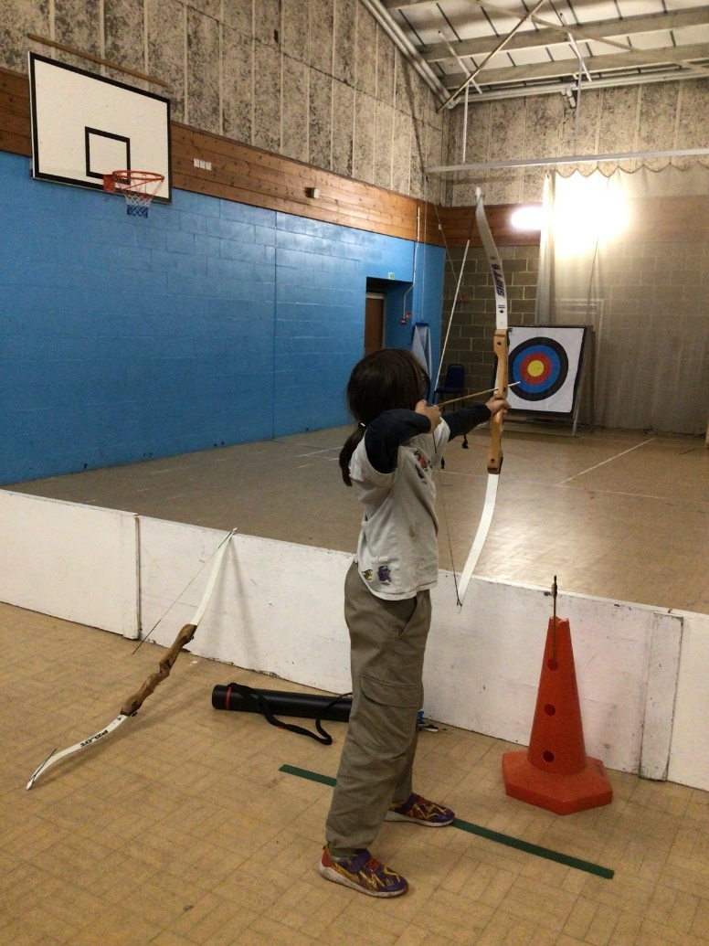
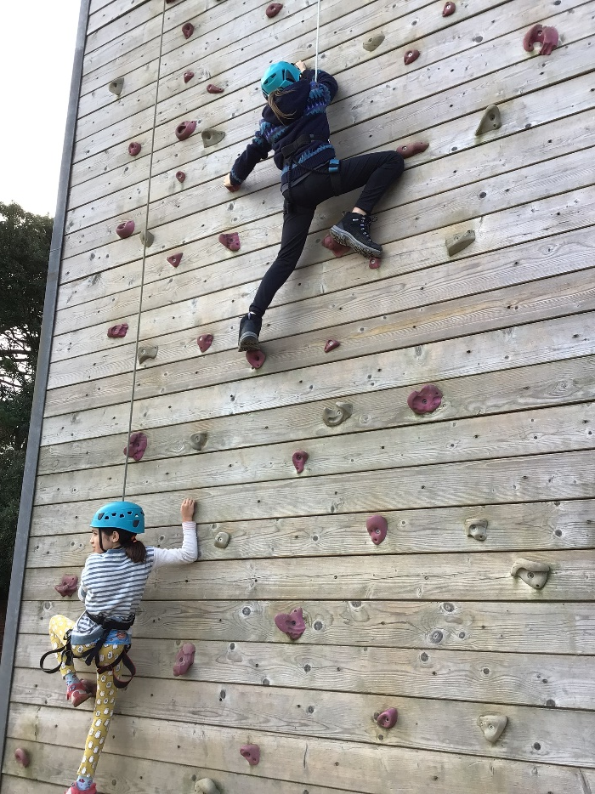
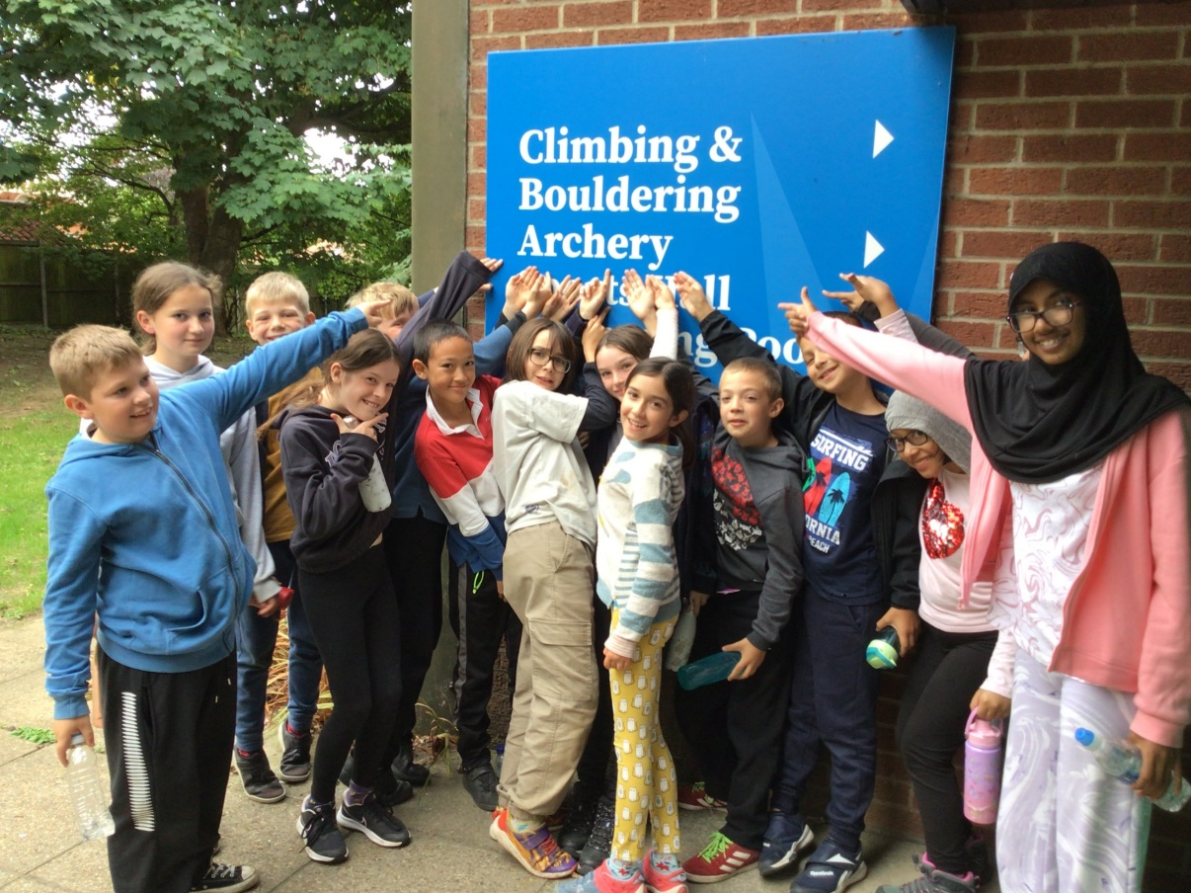

Slide 12
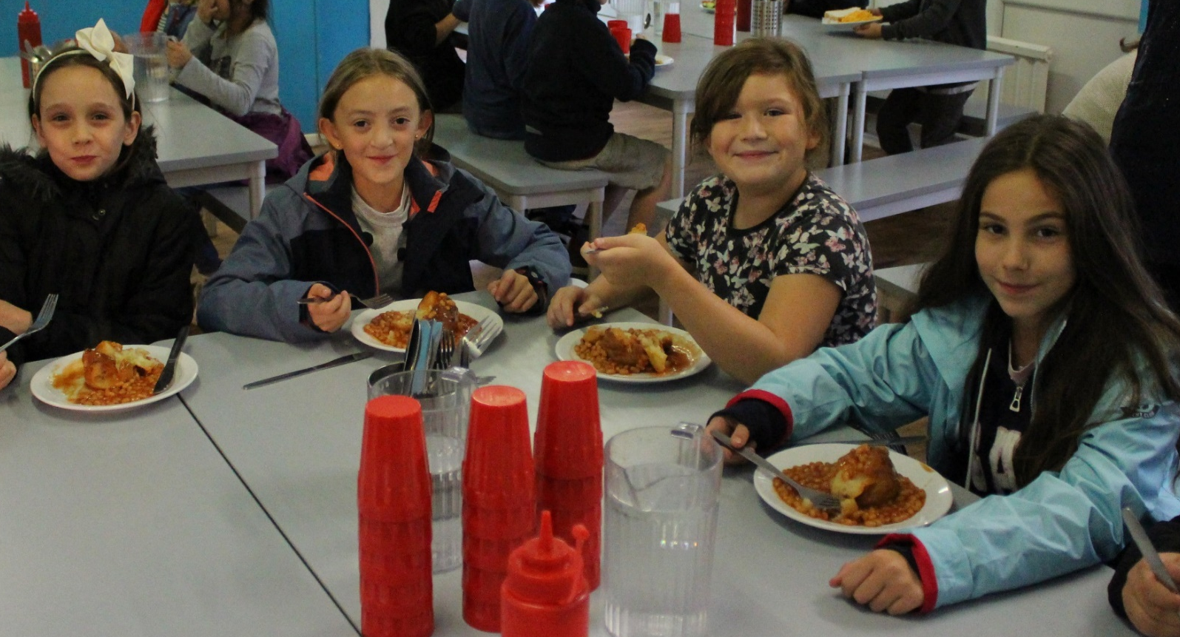

Slide 13
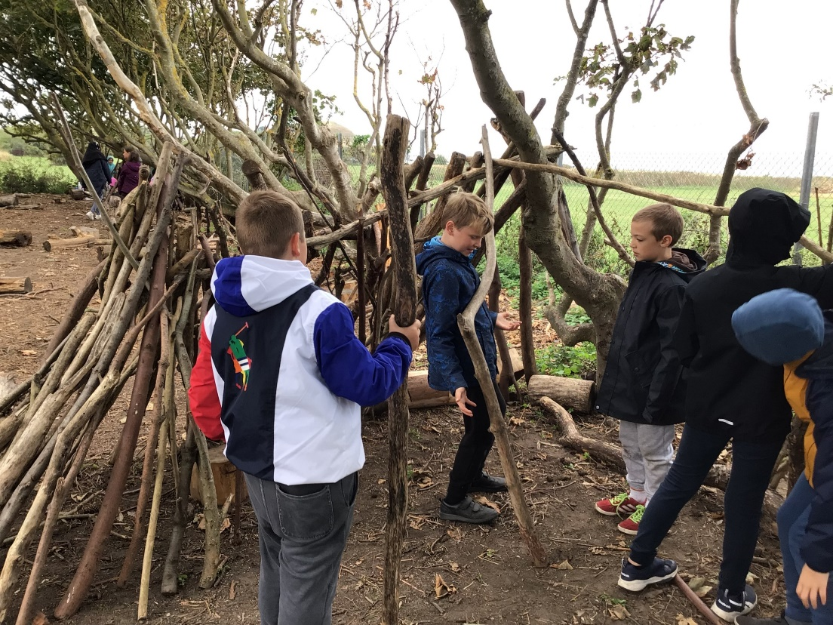
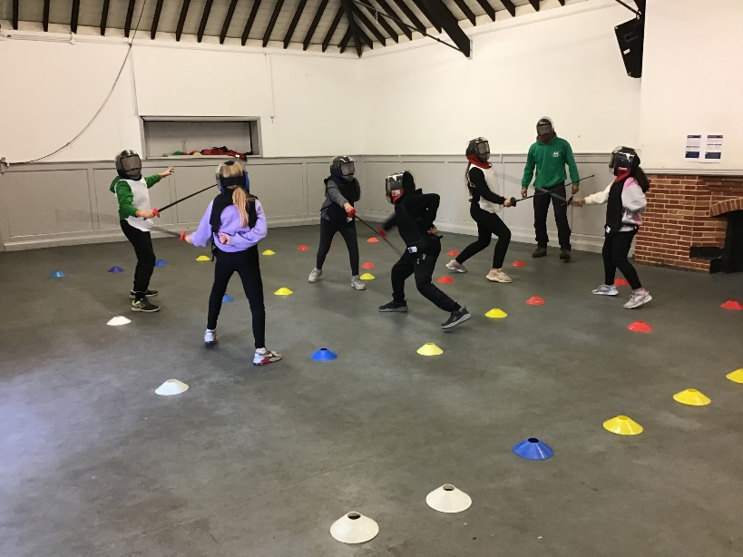
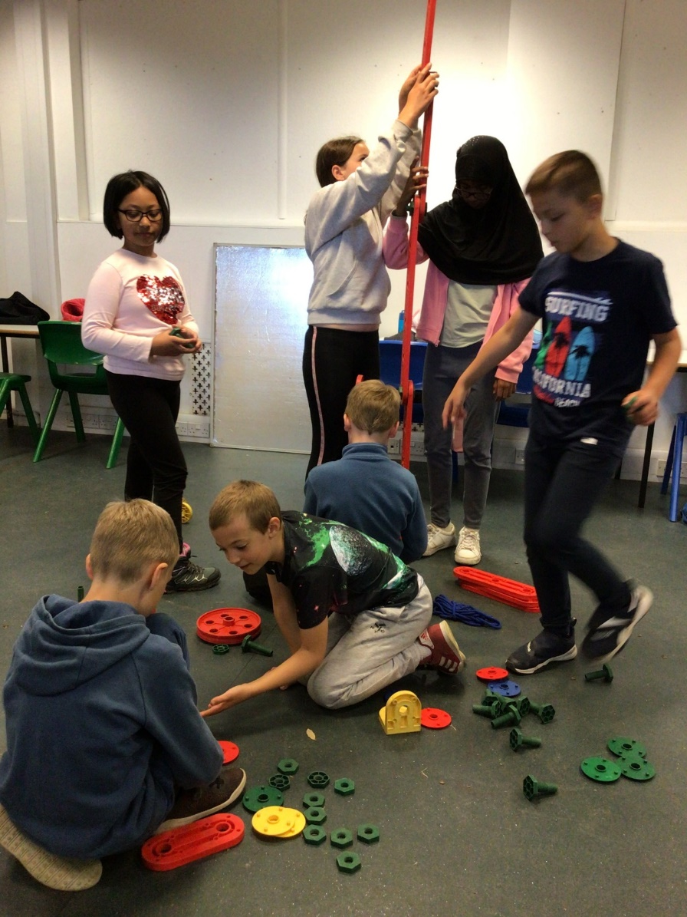
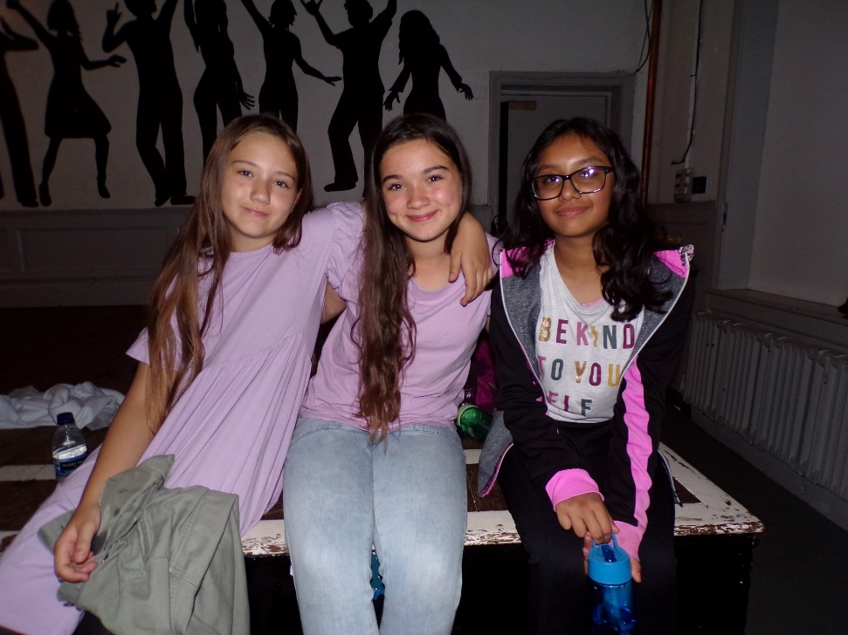
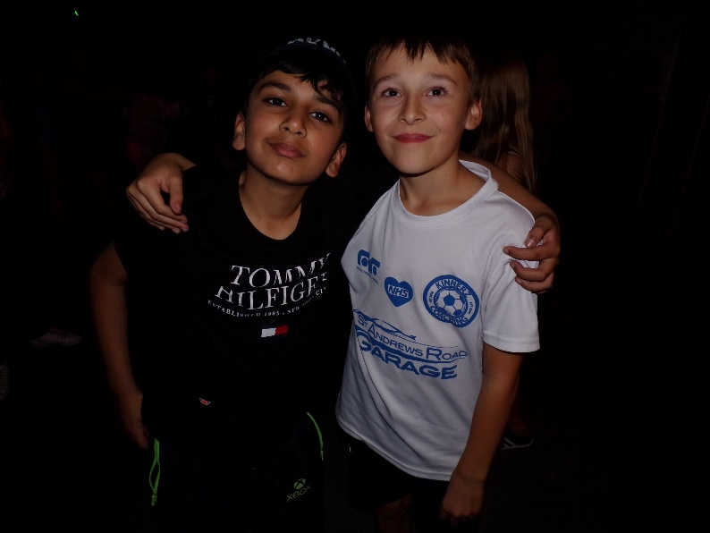

Slide 14
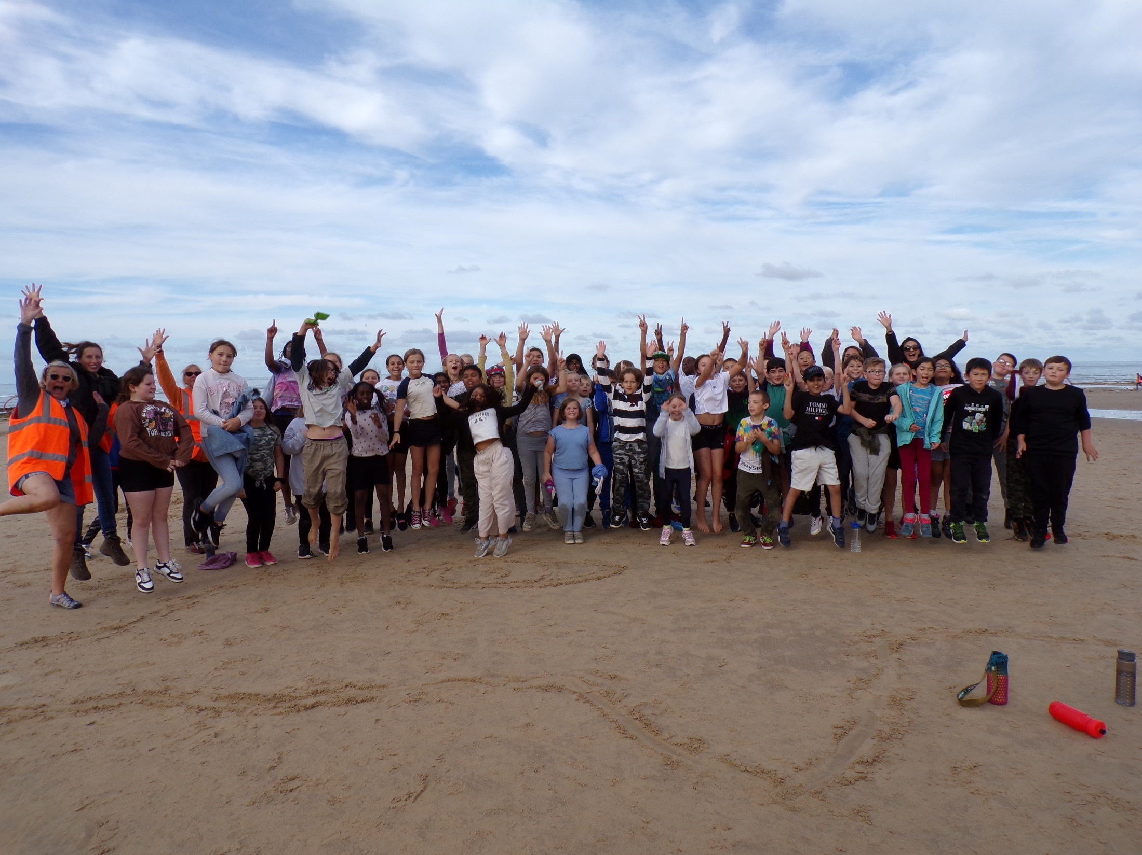

Slide 15
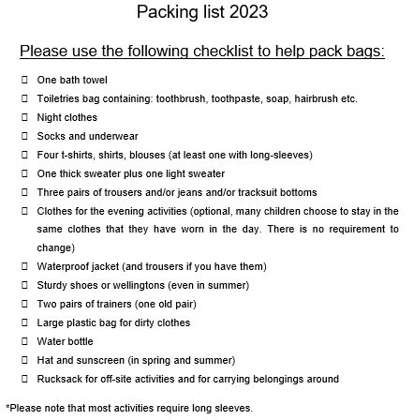
Packing list

Slide 16
Reminders…
Please ensure all clothing is named as it is incredibly difficult to match specific items back to children.
Children should not bring any money with them.
Please do not bring:
Mobile phones, any electronic devices (including cameras, fitbits, electronic games, iPods or MP3 players), expensive or much cherished jewellery, expensive favourite clothing or shoes.
*Kingswood cannot accept liability for the loss, theft or damage of any personal property your child may bring.

Slide 17
Paperwork for the trip
Packing list
Emergency contact details and dietary needs of your child
Medical forms (if needed)
*These forms must be fully completed and returned to your child’s class teacher by Monday 10th July so all information can be collated and shared with Kingswood in advance of our trip in October.

Slide 18

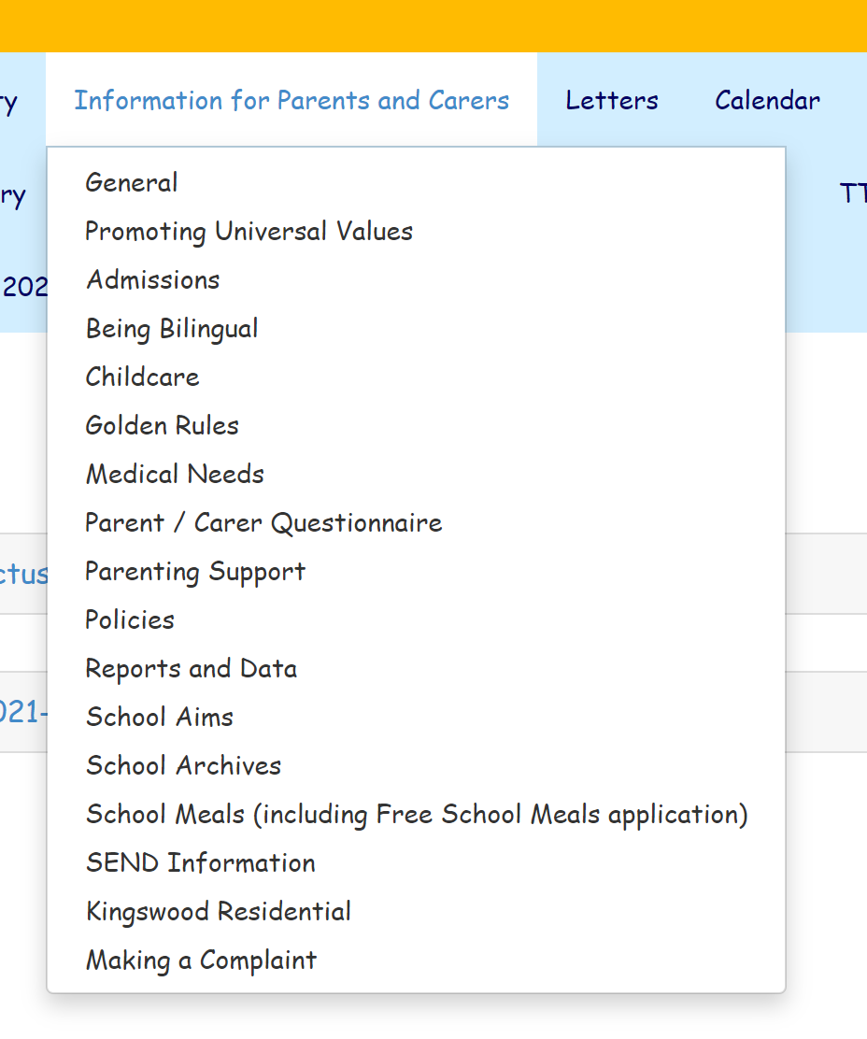
All information for the trip will be added to the below location…

Slide 19


