Slide 1
Year 4 Multiplication Check Parent Information Meeting Thursday 18th May 2023

Slide 2
What is the Multiplication Check?
The purpose of the check is to determine whether your child can fluently recall their times tables up to 12, which is essential for future success in mathematics.
It will also help your us to identify if your child may need additional support.

Slide 3
It is an on-screen check consisting of 25 times table questions.
Your child will be able to answer 3 practice questions before taking the actual check.
They will then have 6 seconds to answer each question. There is a 3 second pause between each question.
On average, the check should take no longer than 5 minutes to complete.
The check is done on a computer and the format is similar to the image to the right.

Slide 4
When/where is the check taking place?
Schools have a two week window in which to take the test between 5th June to 16th June.
The check will take place either in the school computer suite or classrooms. Children will either use desktop computers or iPads to complete the check.

Slide 5
Access arrangements
There are several access arrangements available for the check, which can be used to support pupils with specific needs. Your child’s teacher, with support from the Senior Management Team, will ensure that the access arrangements are appropriate for your child before they take the check in June.
The check has been designed so that it is inclusive and accessible to as many children as possible, including those with special educational needs or disability (SEND) or English as an additional language (EAL). However, there may be some circumstances in which it will not be appropriate for a pupil to take the check, even when using suitable access arrangements.

Slide 6
Preparing for the check
Children have been learning and practising their times tables facts since Year 2. In Year 4, they have had lots of opportunities to consolidate their times tables with regular practise.
We will ensure that children have opportunities over the next few weeks to familiarise themselves with the style of the check application and try out any access arrangements that may be required.
It is very important that children continue to practice times tables at home using TTRS. Please do support them at home with this.

Slide 7
Results from the check
There is no ‘pass mark’ for the check.
Schools will use the results to identify any further support or interventions classes, groups or individuals may need.
You will receive your child’s mark from the check with their end of year report.
Results will only be published at national and local-authority level; school-level data will not be published.

Slide 8
Ways to help at home…
Continue to use TT Rockstars daily at home
Use flashcards to practise quick fire times tables questions and play times tables games.
The following website could be useful as it is similar to the check:
https://mathsframe.co.uk/en/resources/resource/477/Multiplication-Tables-Check

Slide 9
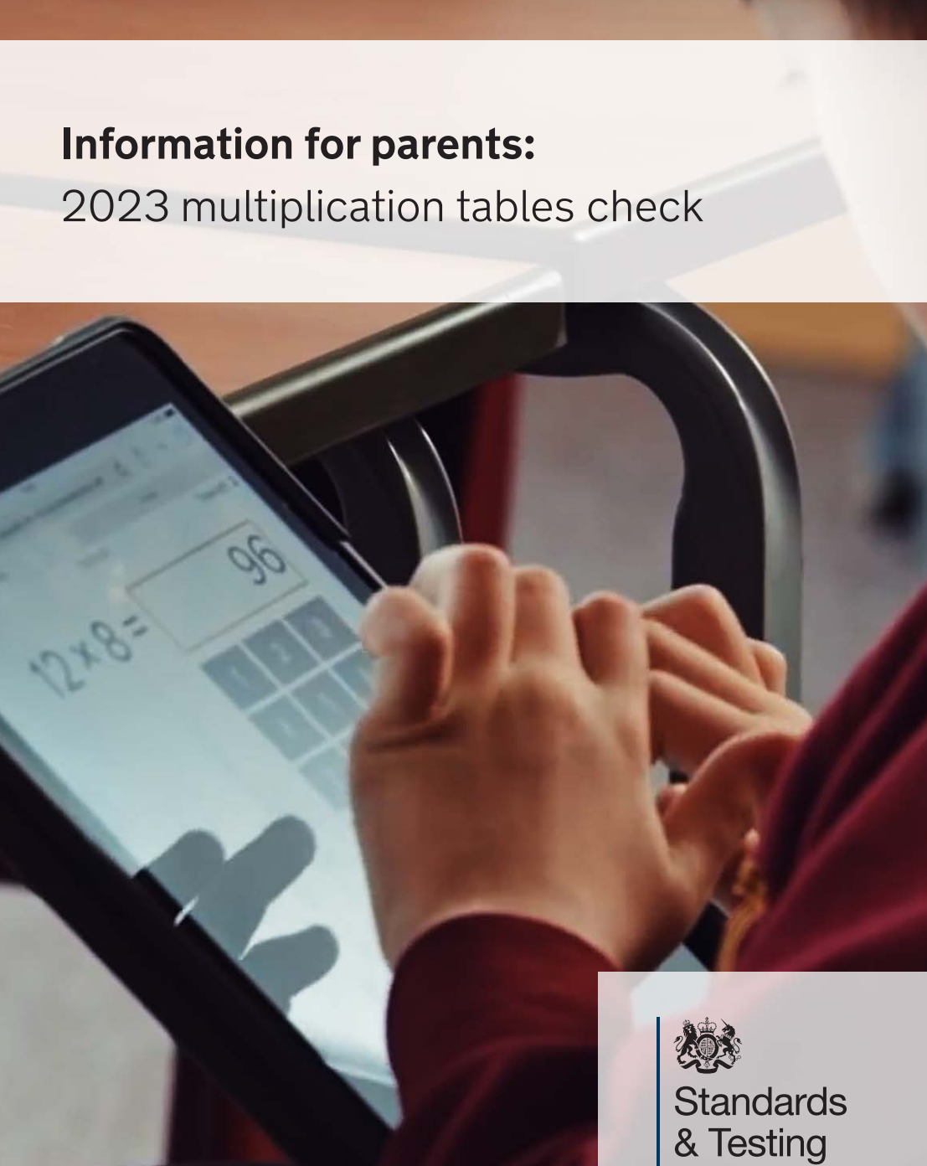
Information booklet for parents regarding the Multiplication Check:
https://assets.publishing.service.gov.uk/government/uploads/system/uploads/attachment_data/file/1116420/2023_Information_for_parents_Multiplication_tables_check_Nov_22_PDFA.pdf

Slide 10
Questions?

